Slide 1
Transition Path
Electricity Mismatch Analysis

Slide 2
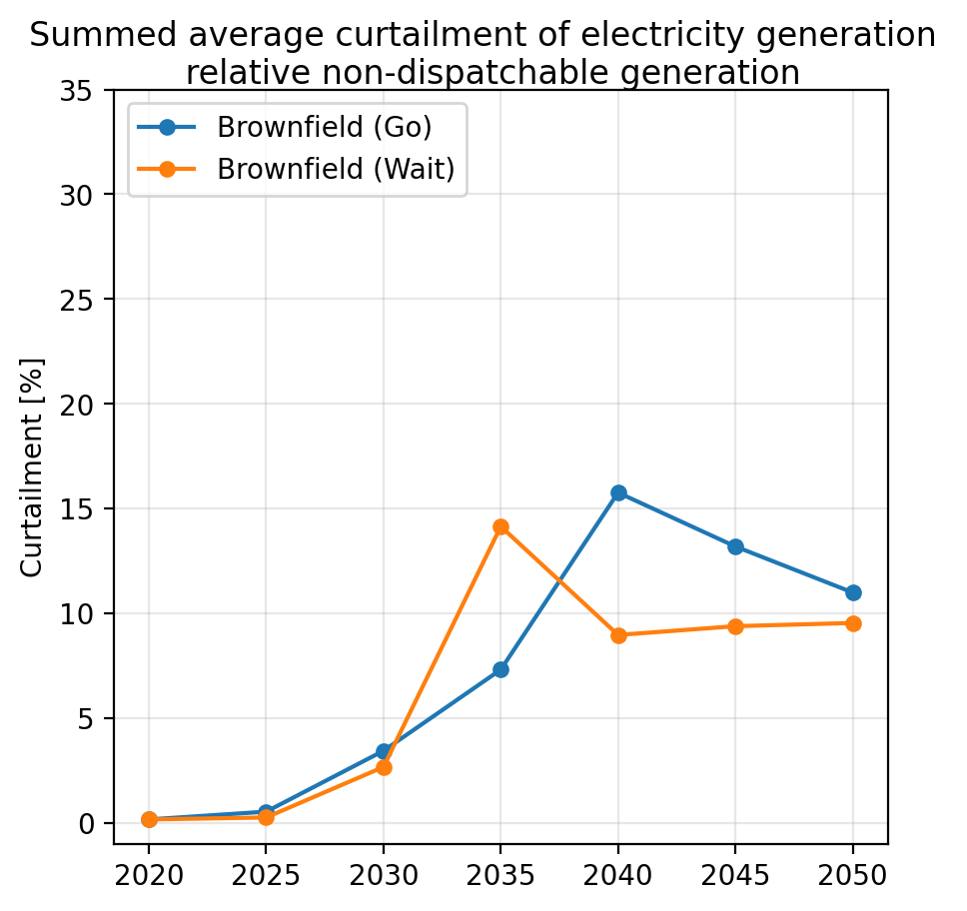
Pre-analysis - Curtailment

Slide 3
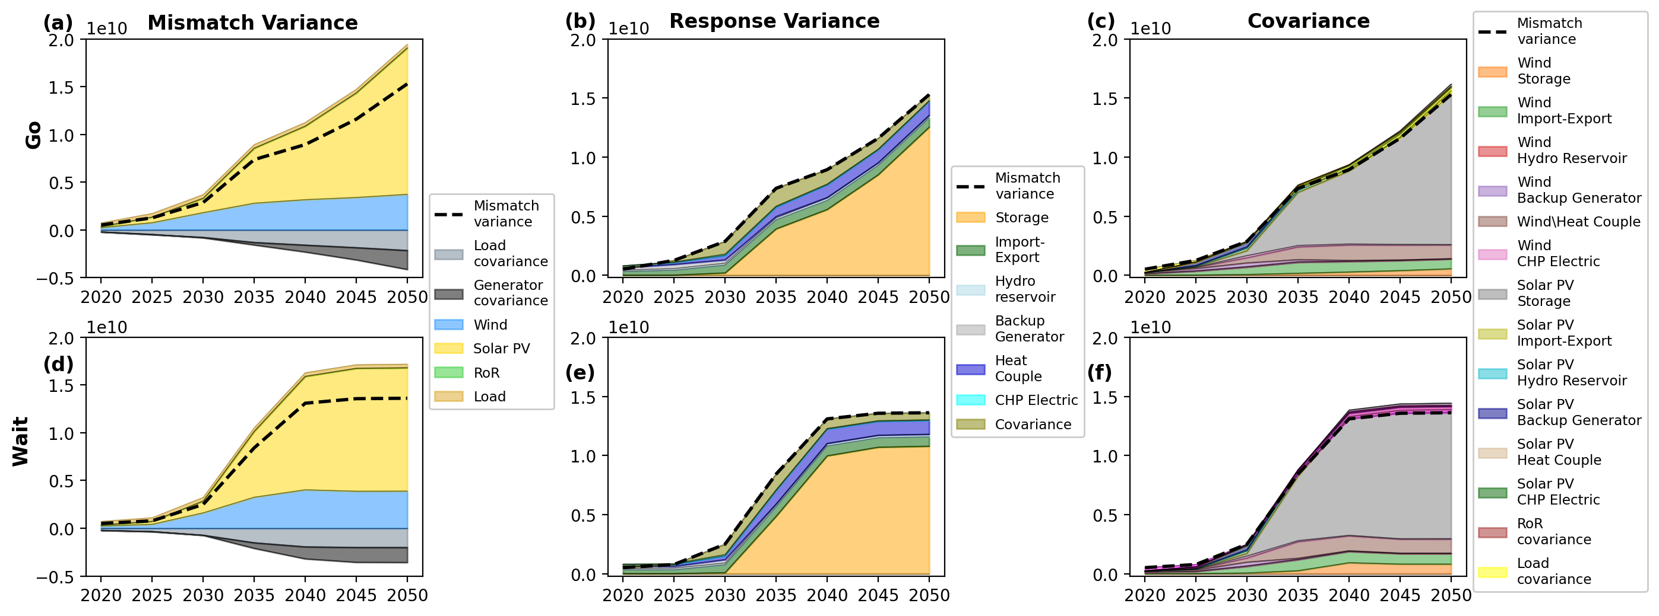
Pre-analysis – Variance & Cross Corilation

Slide 4
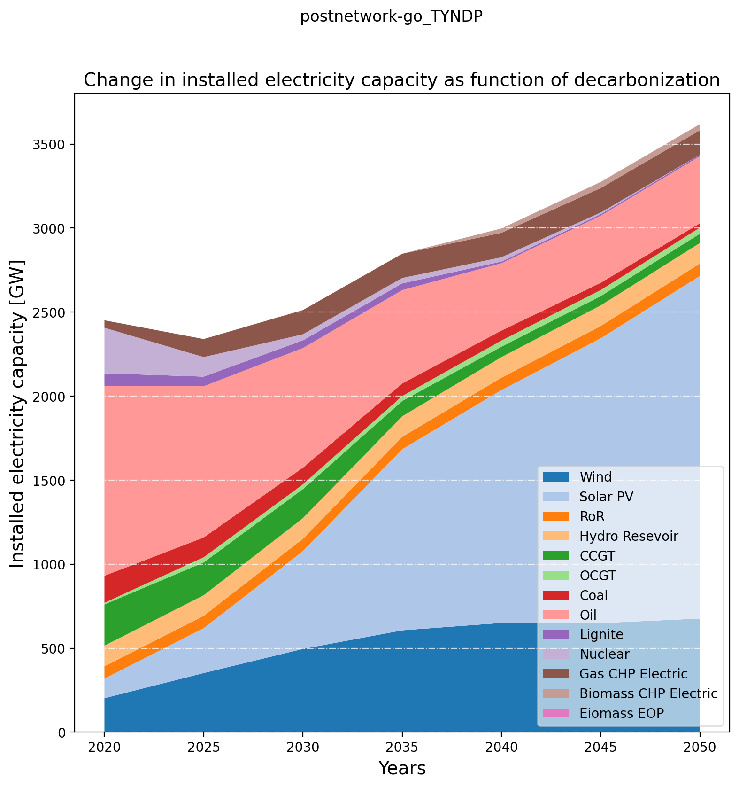
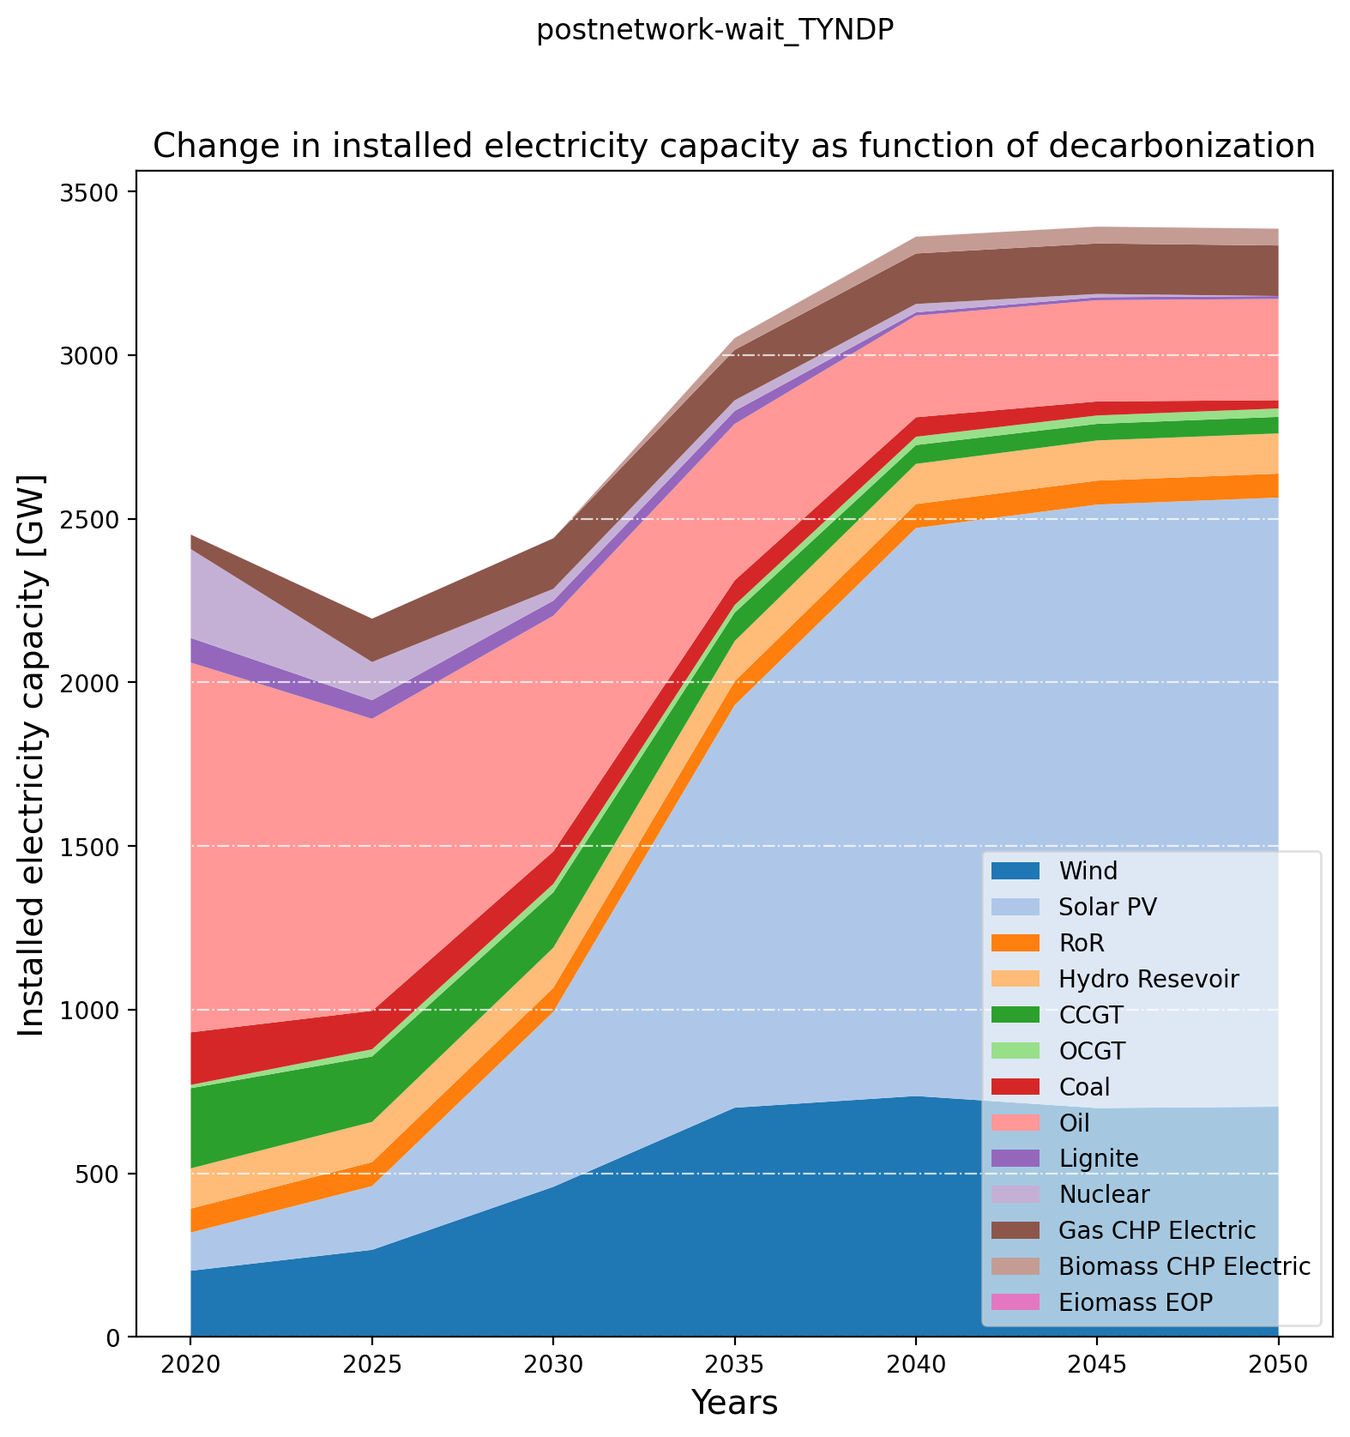
Pre-analysis – Electricity Installed Capacity

Slide 5
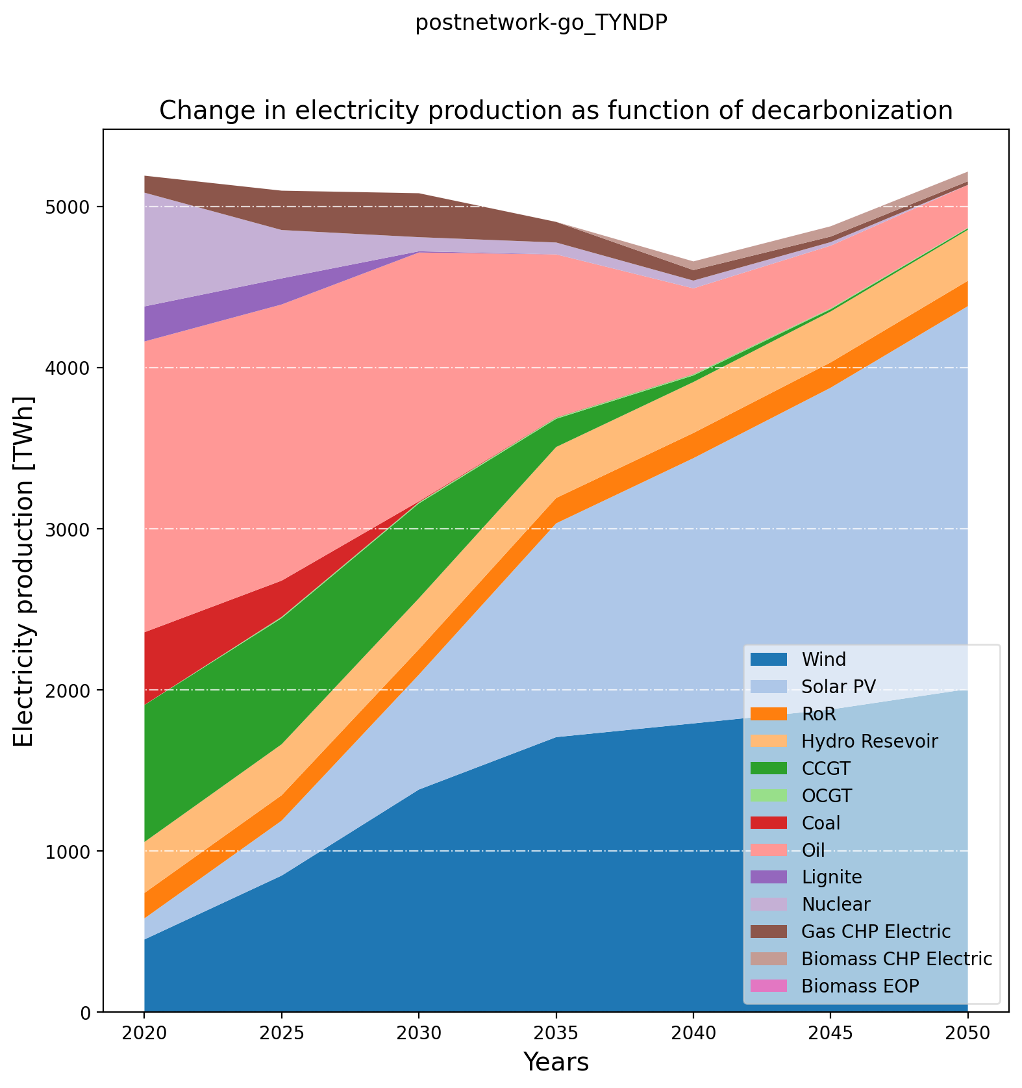
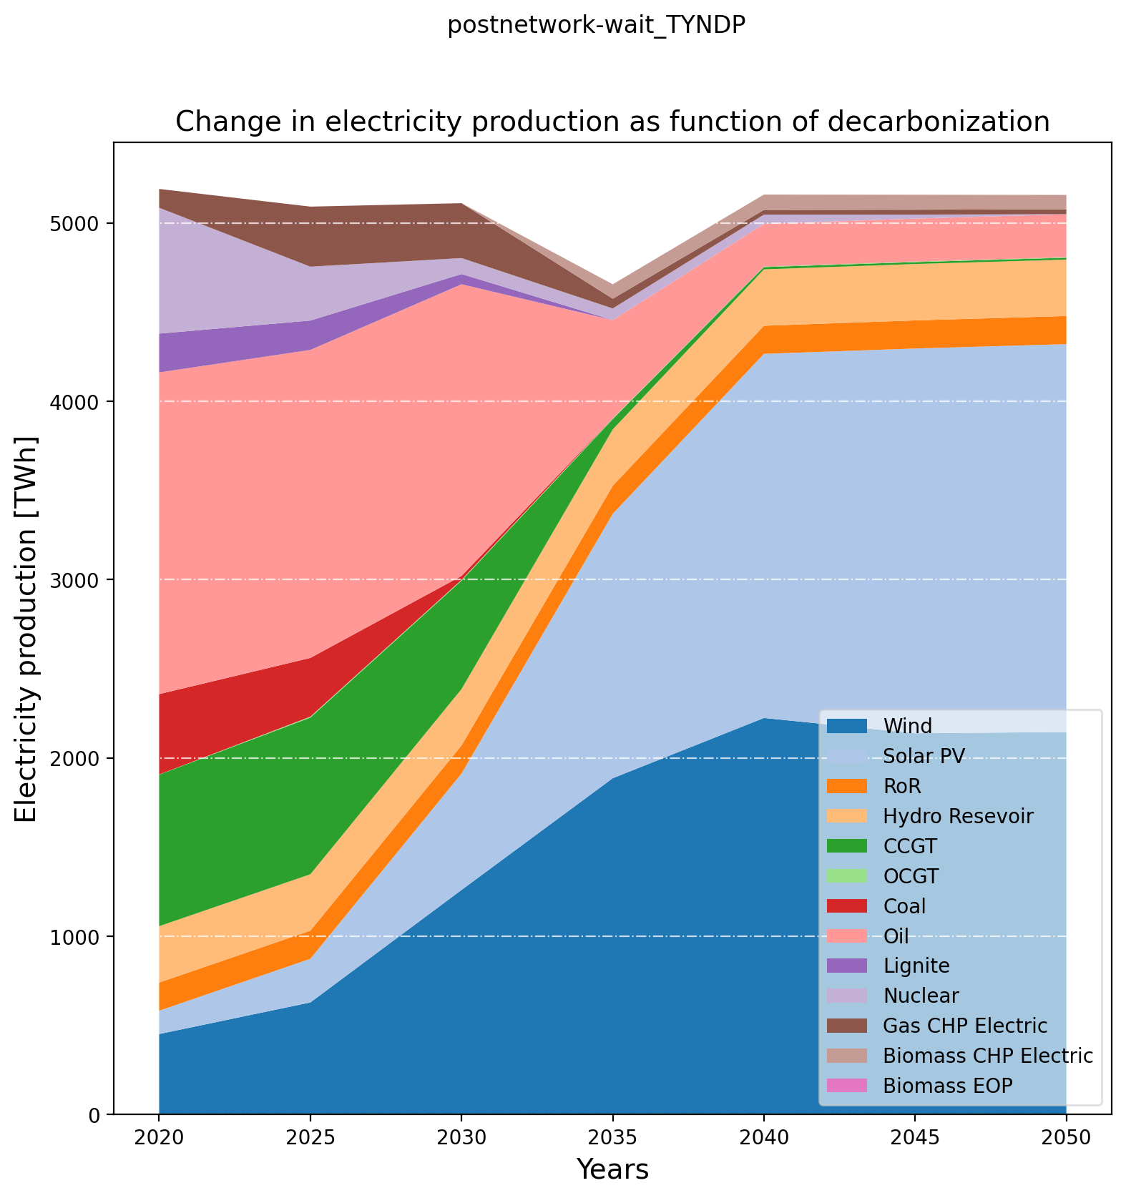
Pre-analysis – Electricity Production

Slide 6
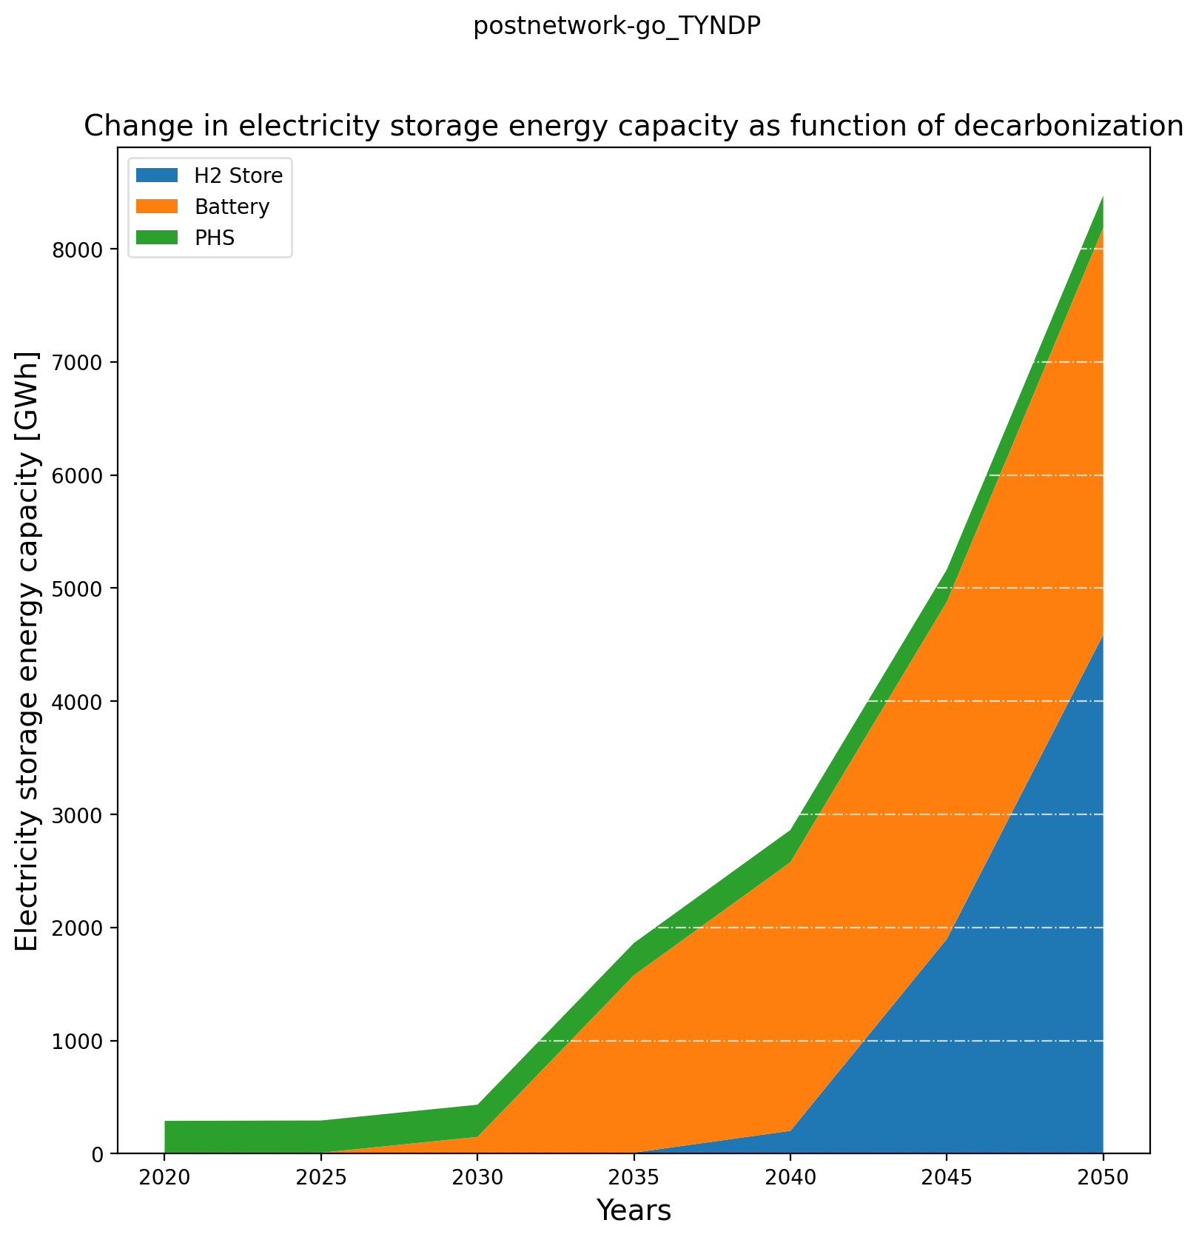
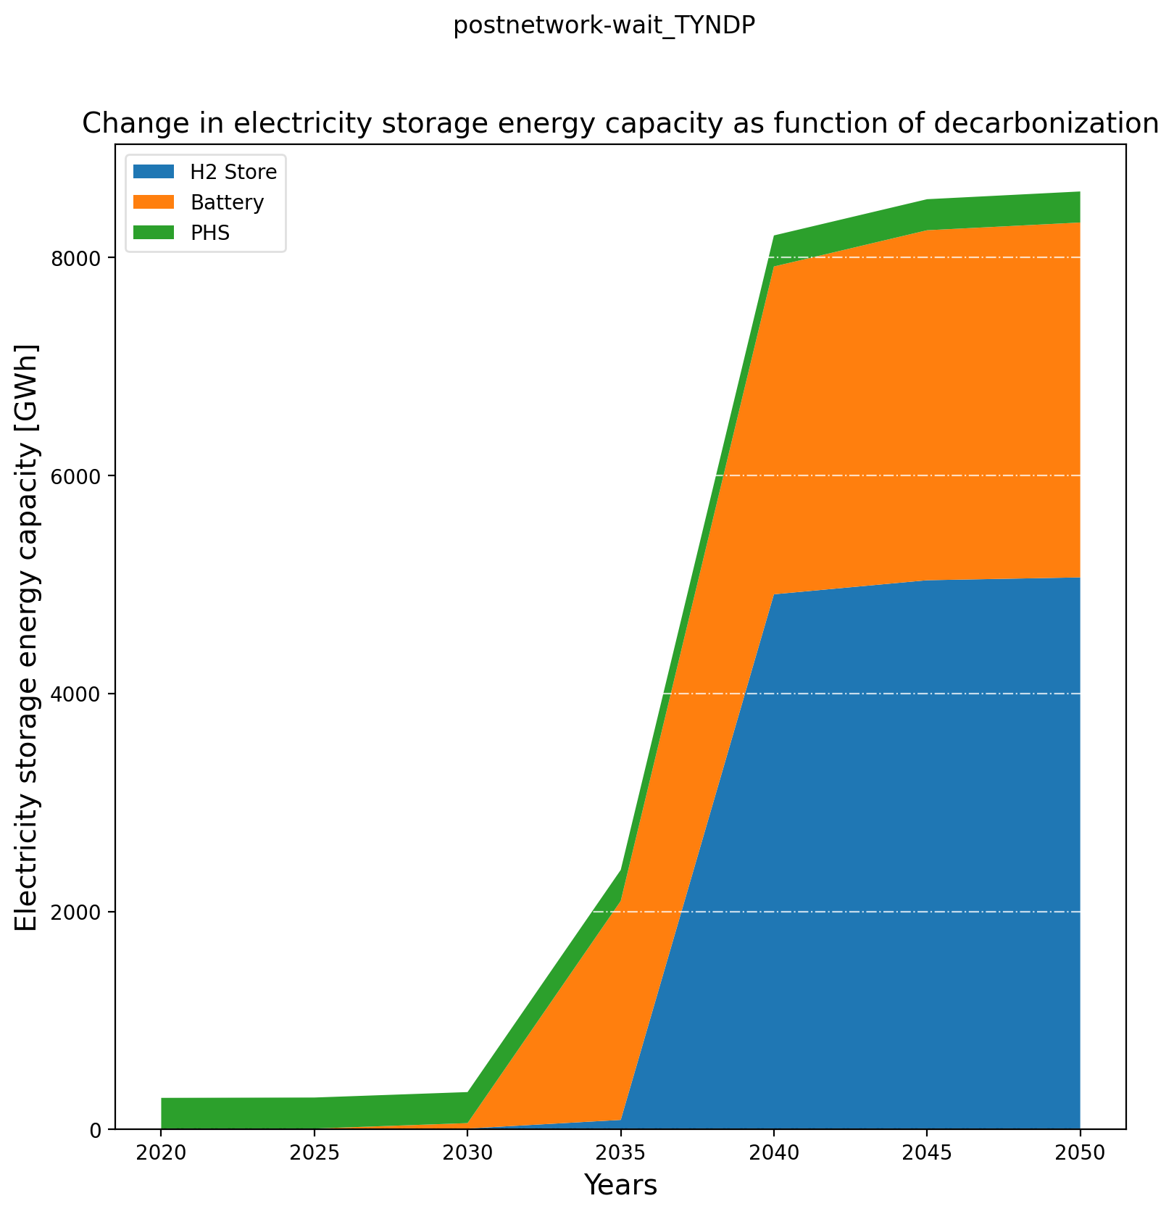
Pre-analysis – Electricity Storage Installed Capacity

Slide 7
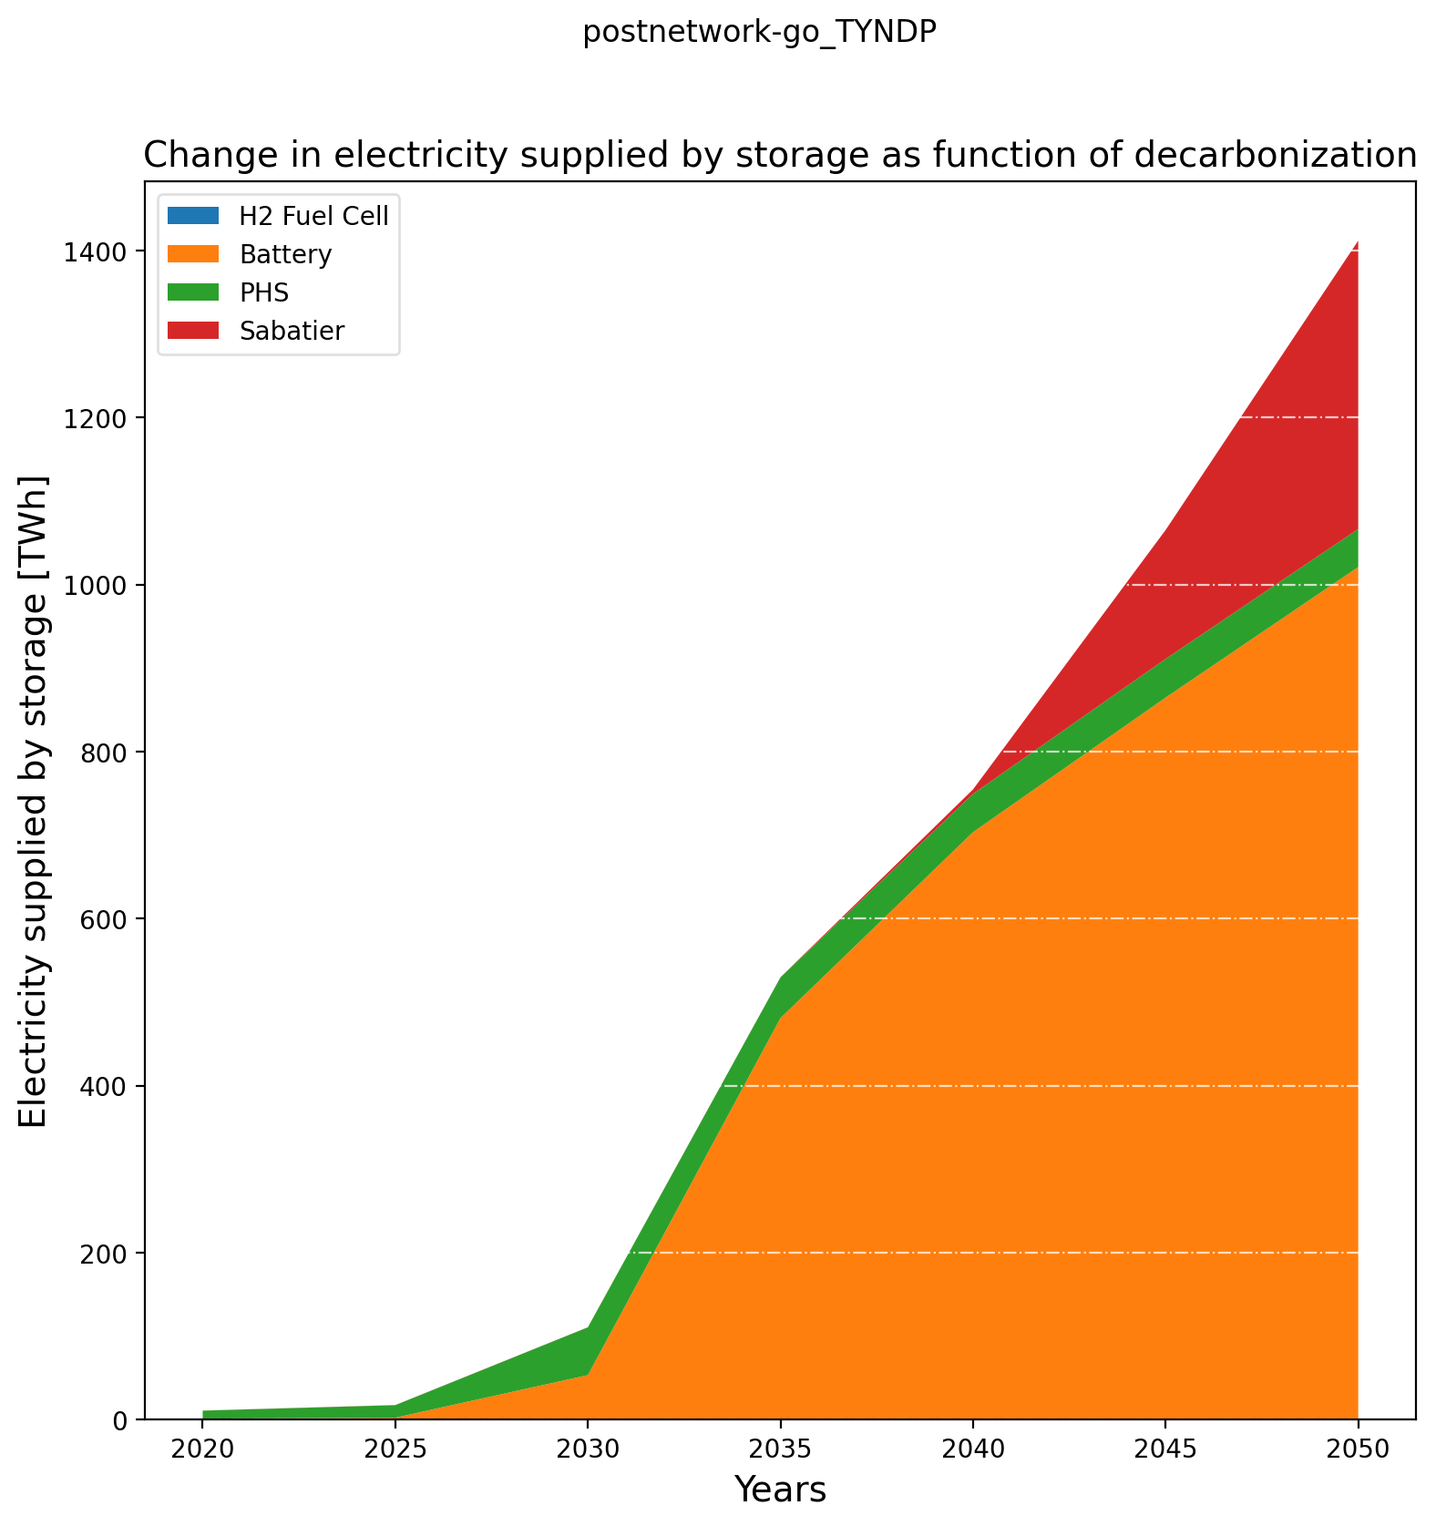
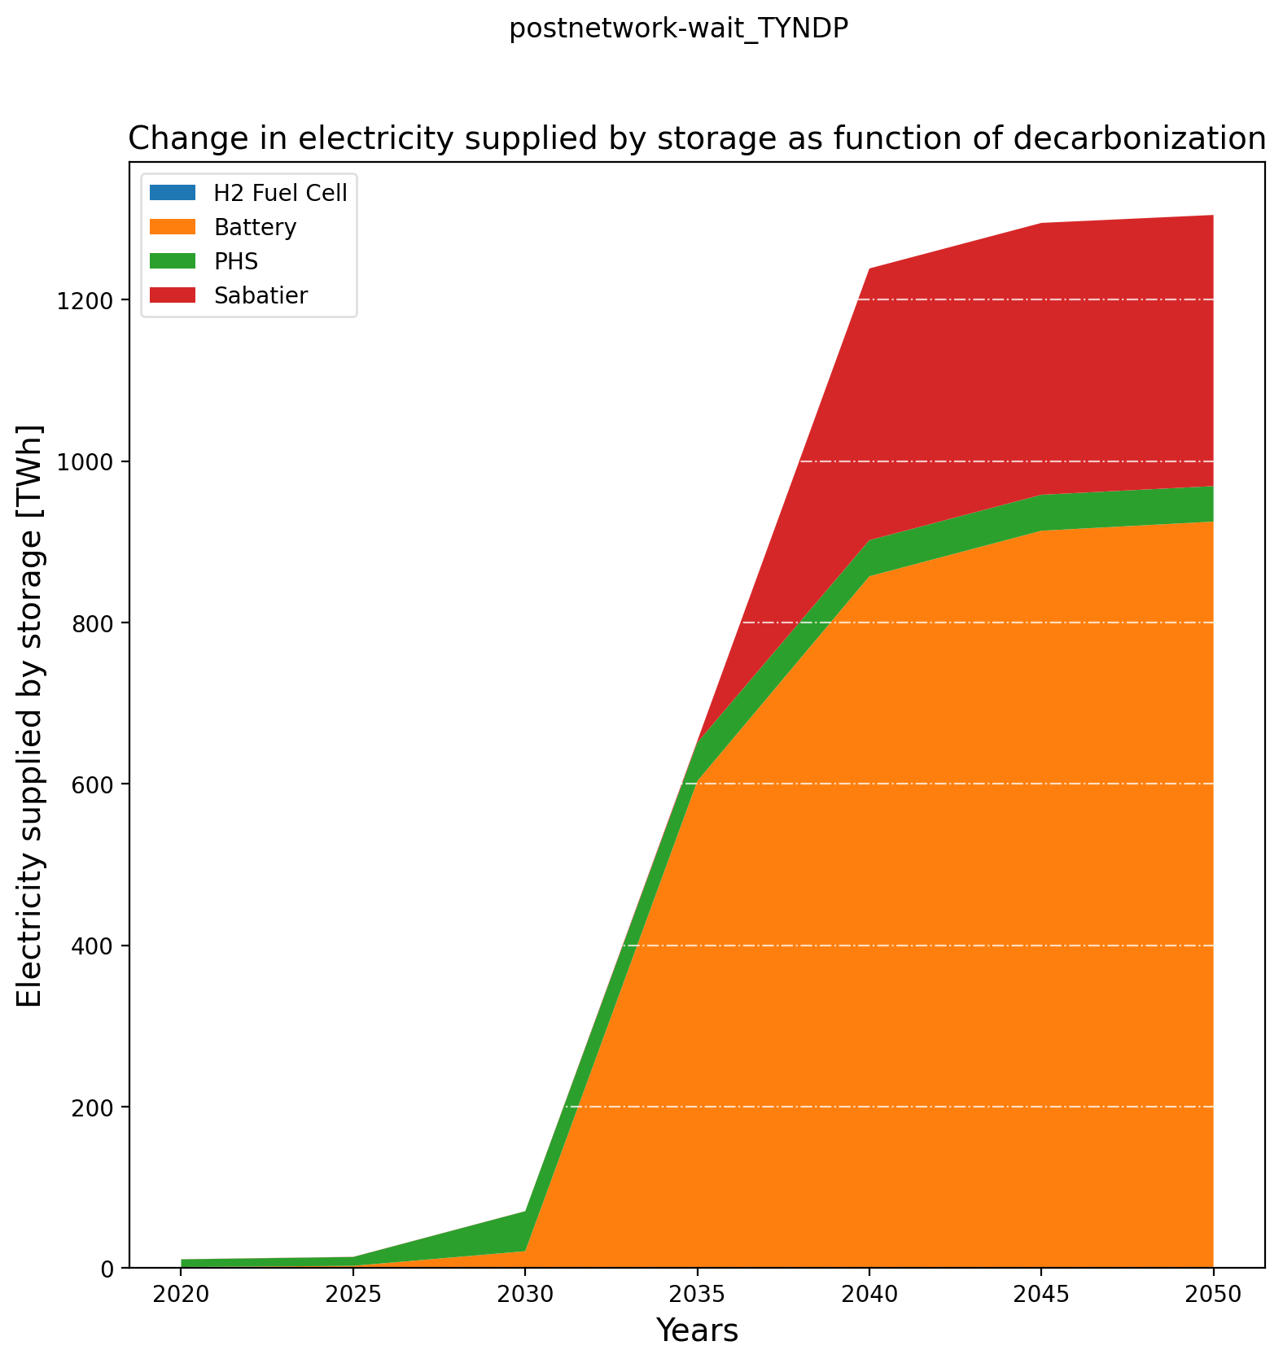
Pre-analysis – Electricity Storage Production

Slide 8
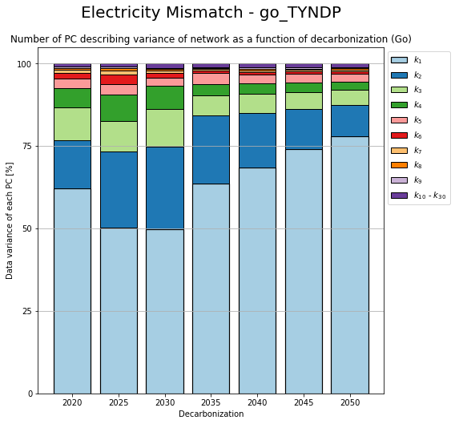
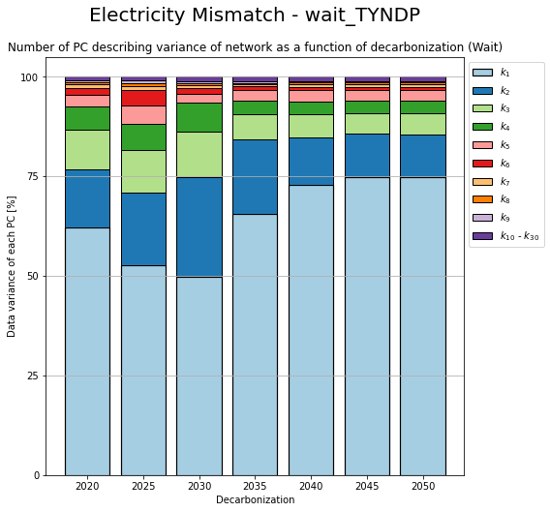
PCA – Change in components

Slide 9
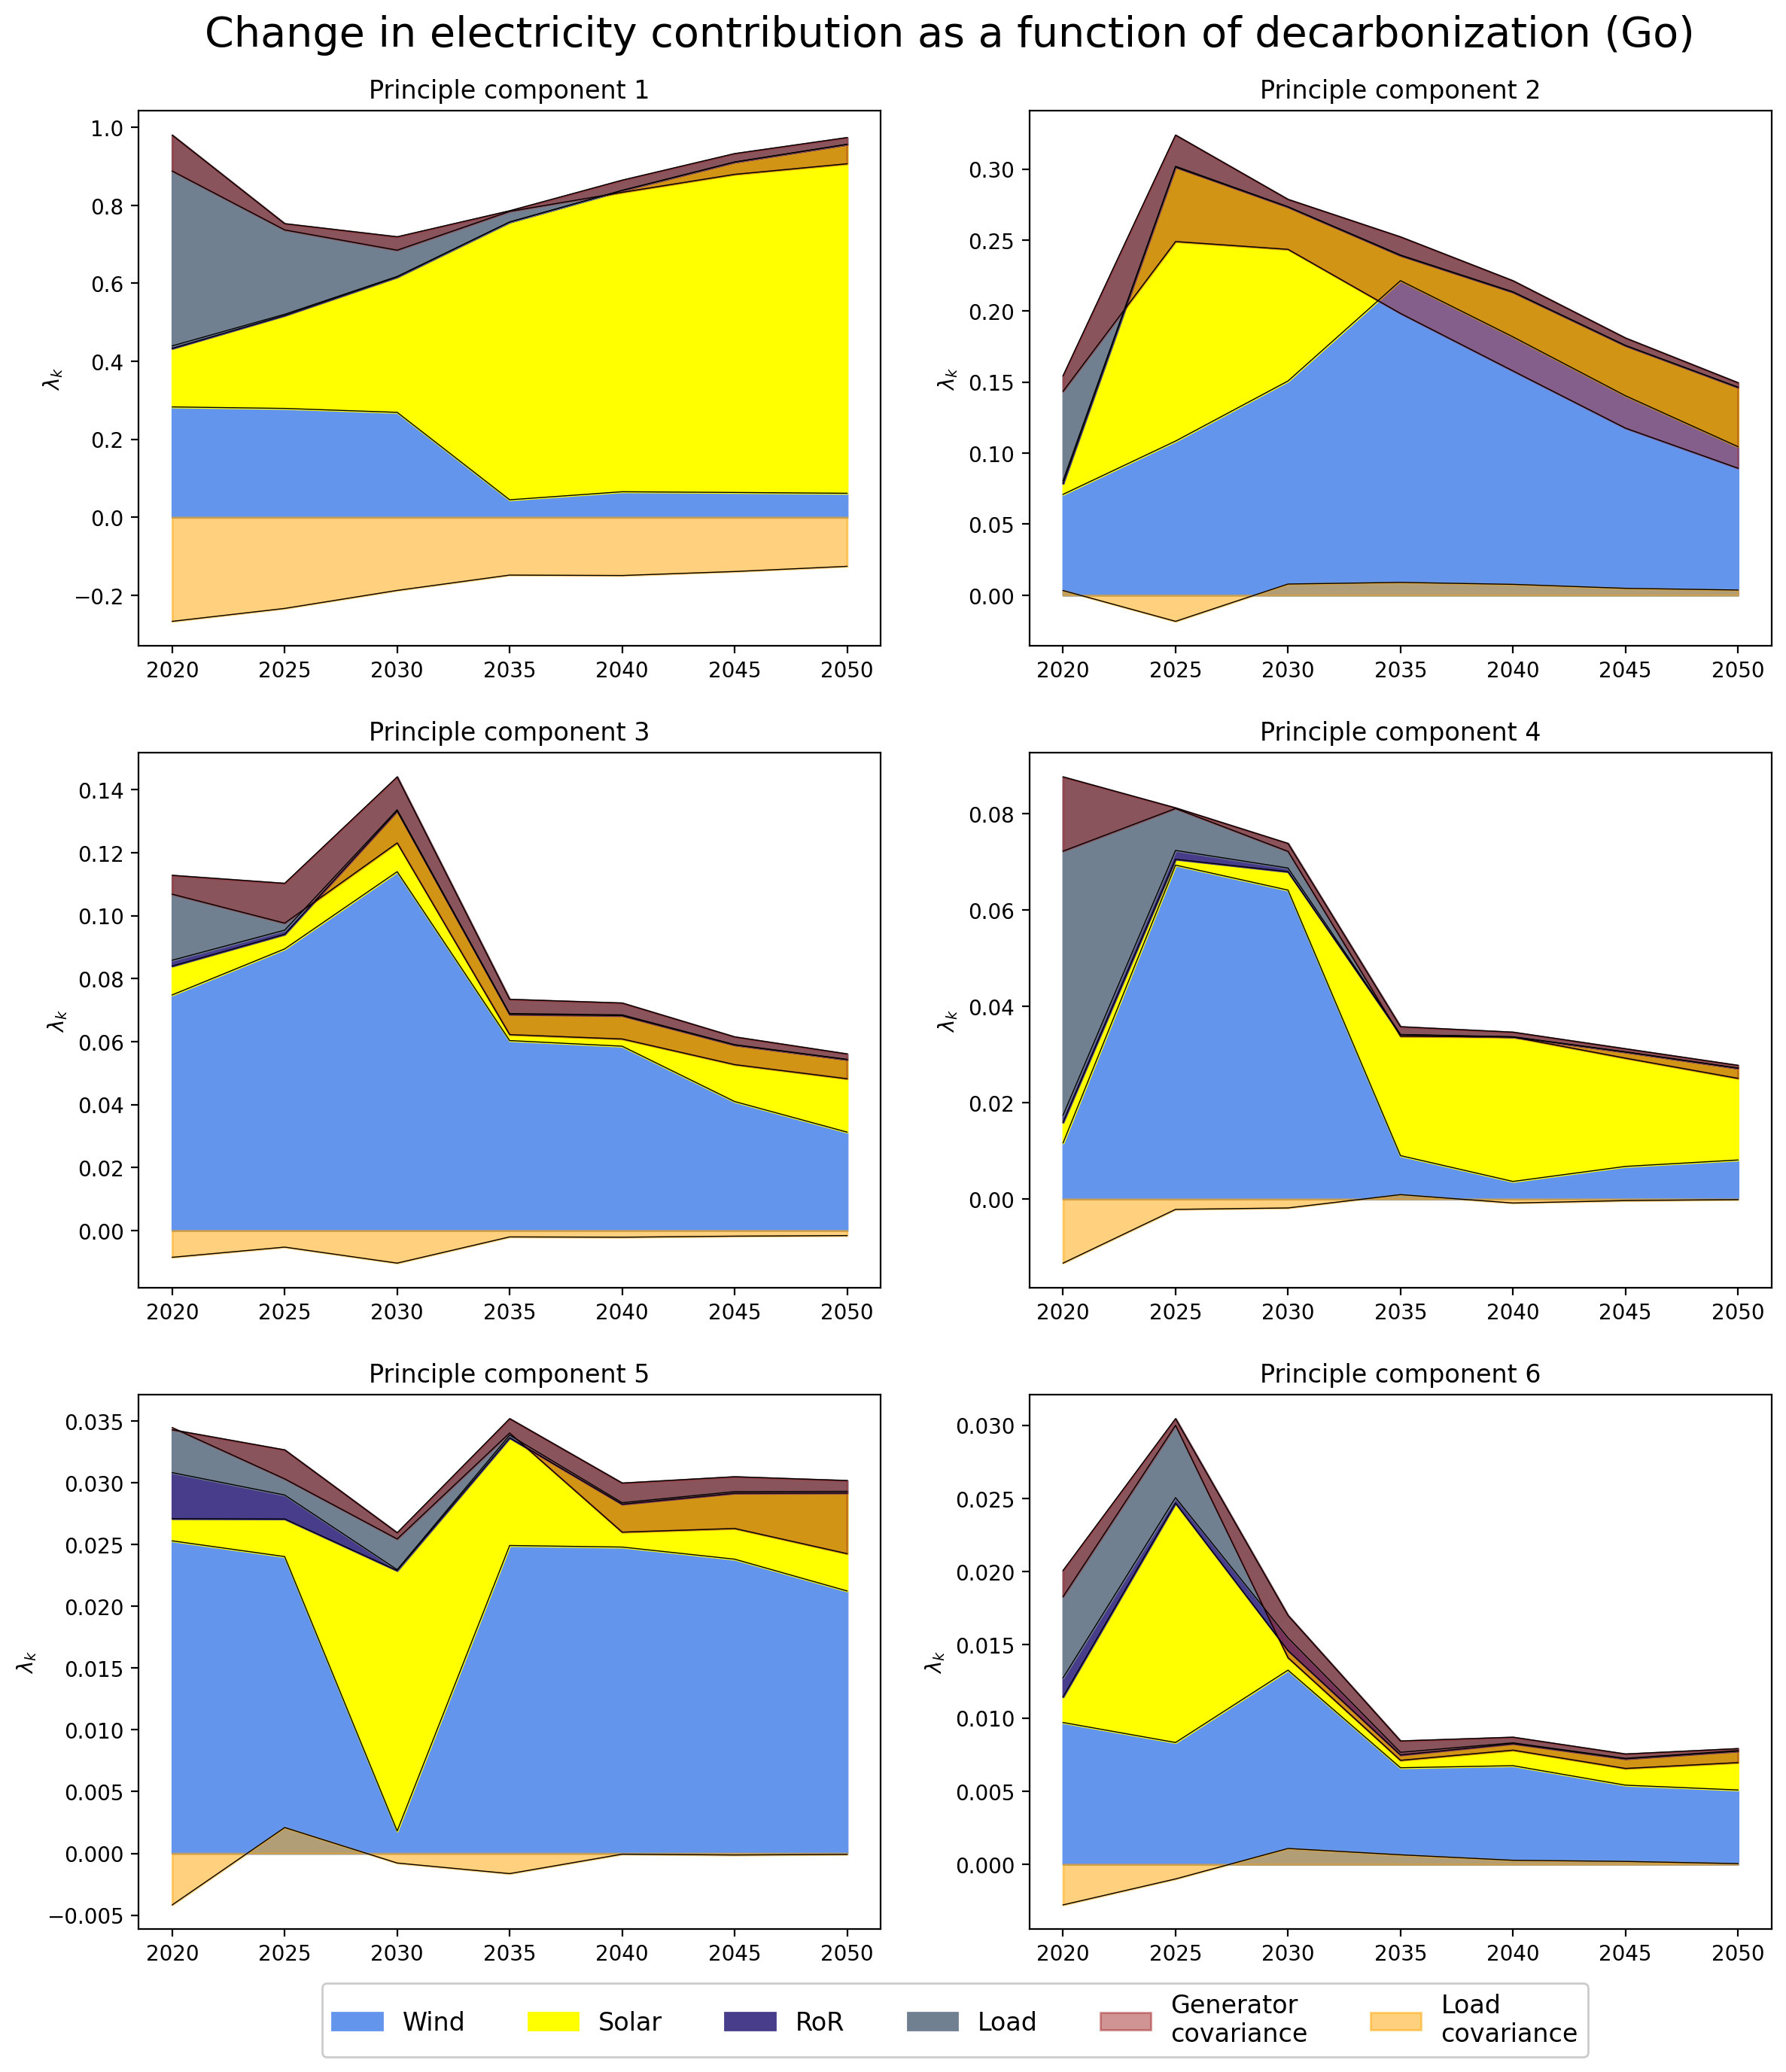
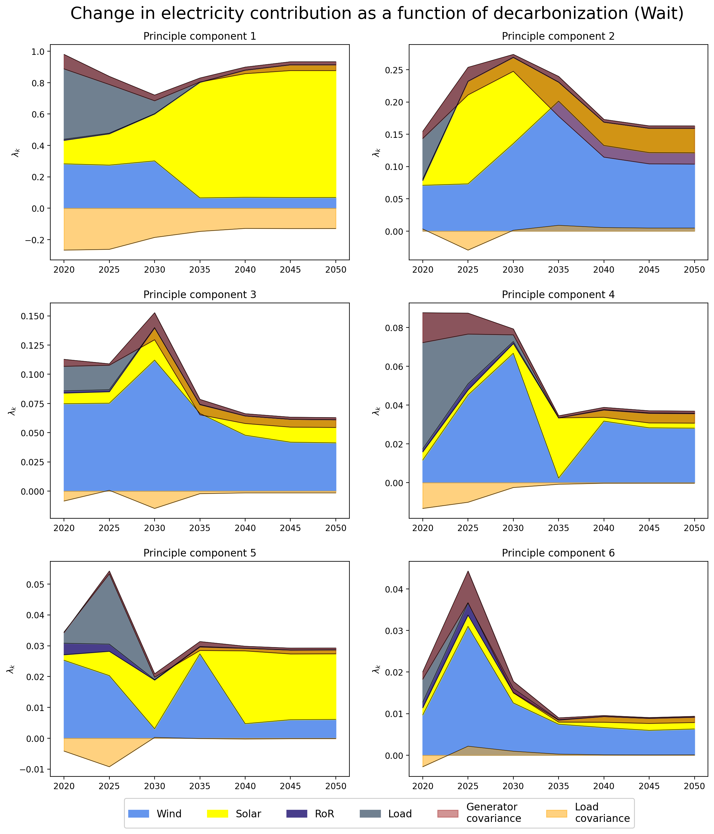
PCA – Change in Contribution

Slide 10
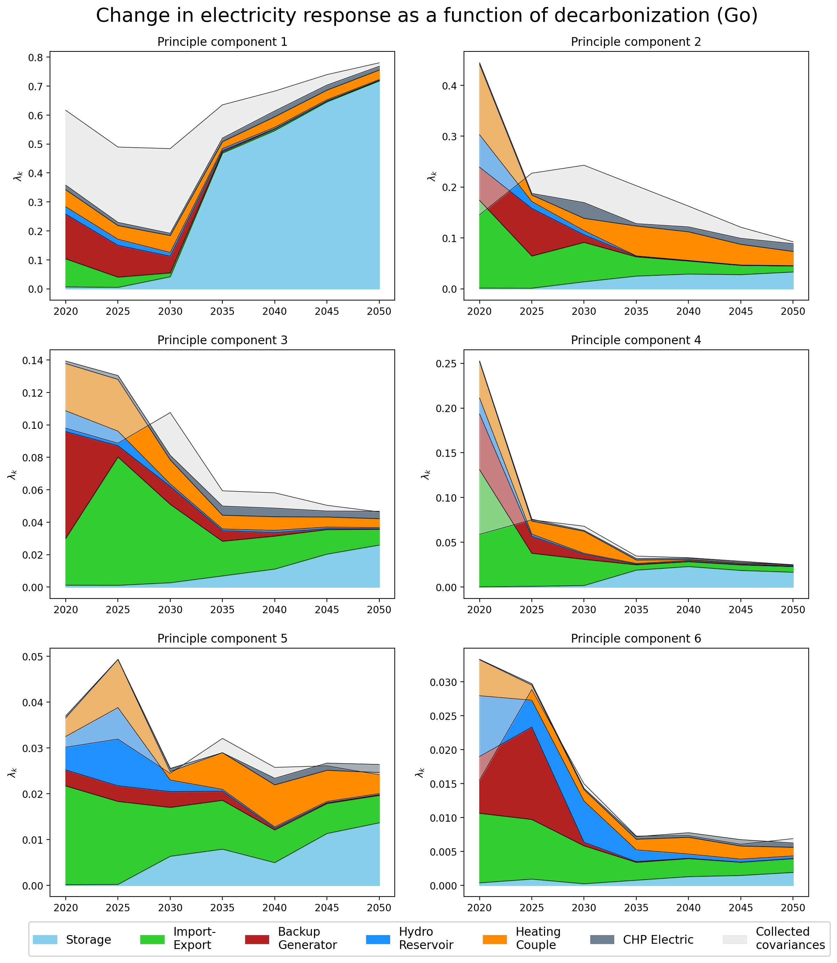
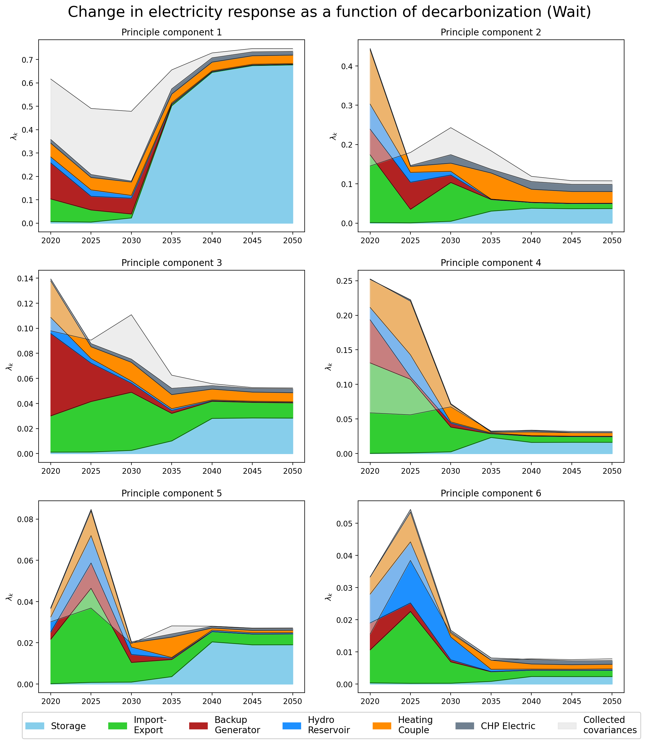
PCA – Change in Response

Slide 11
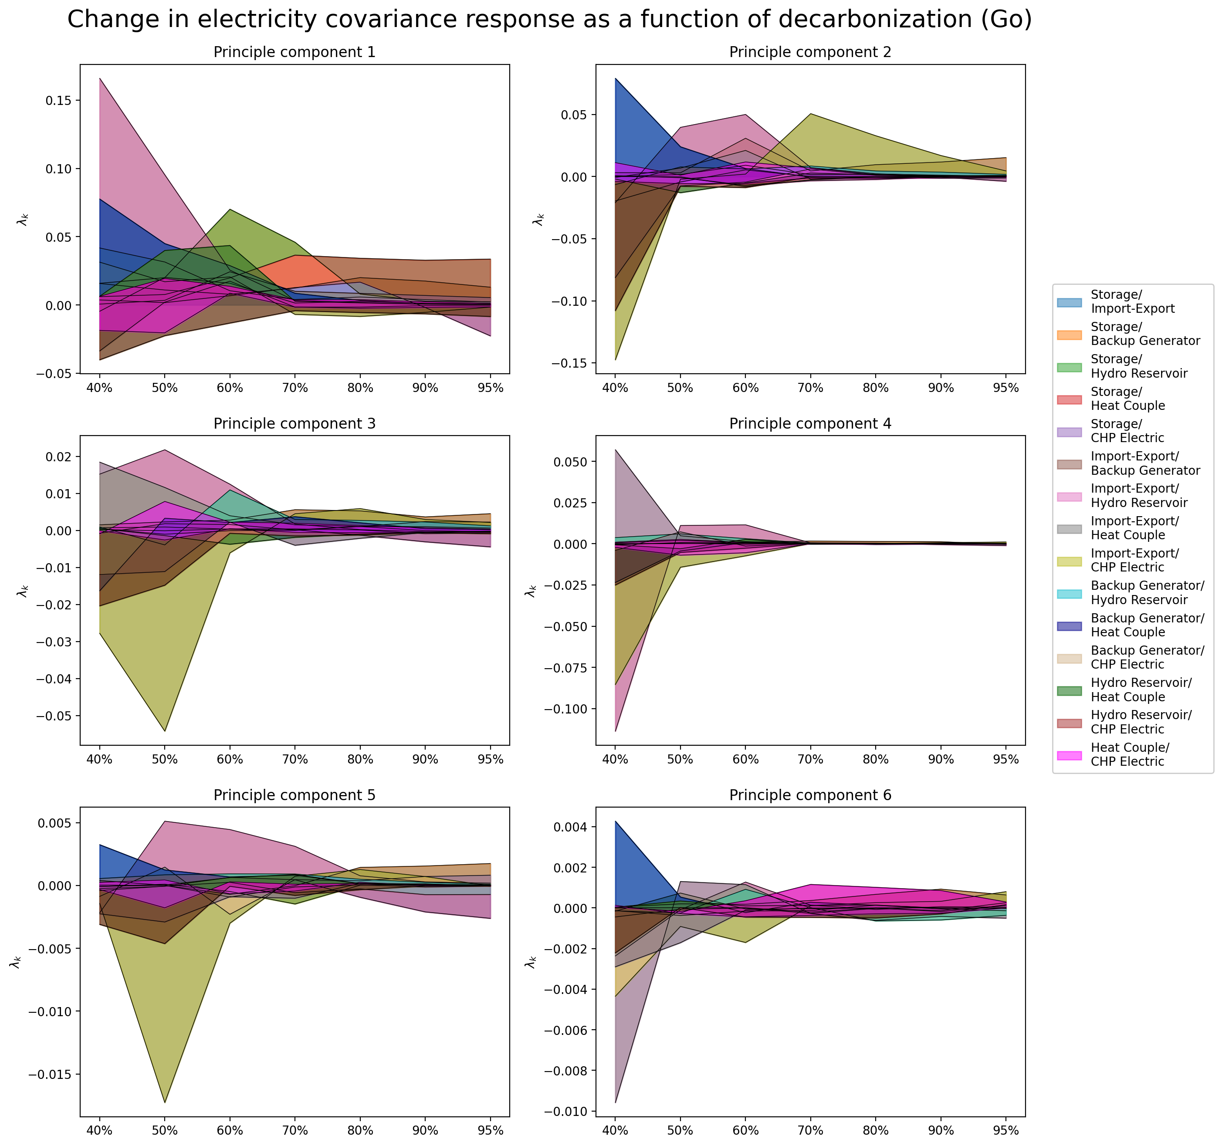
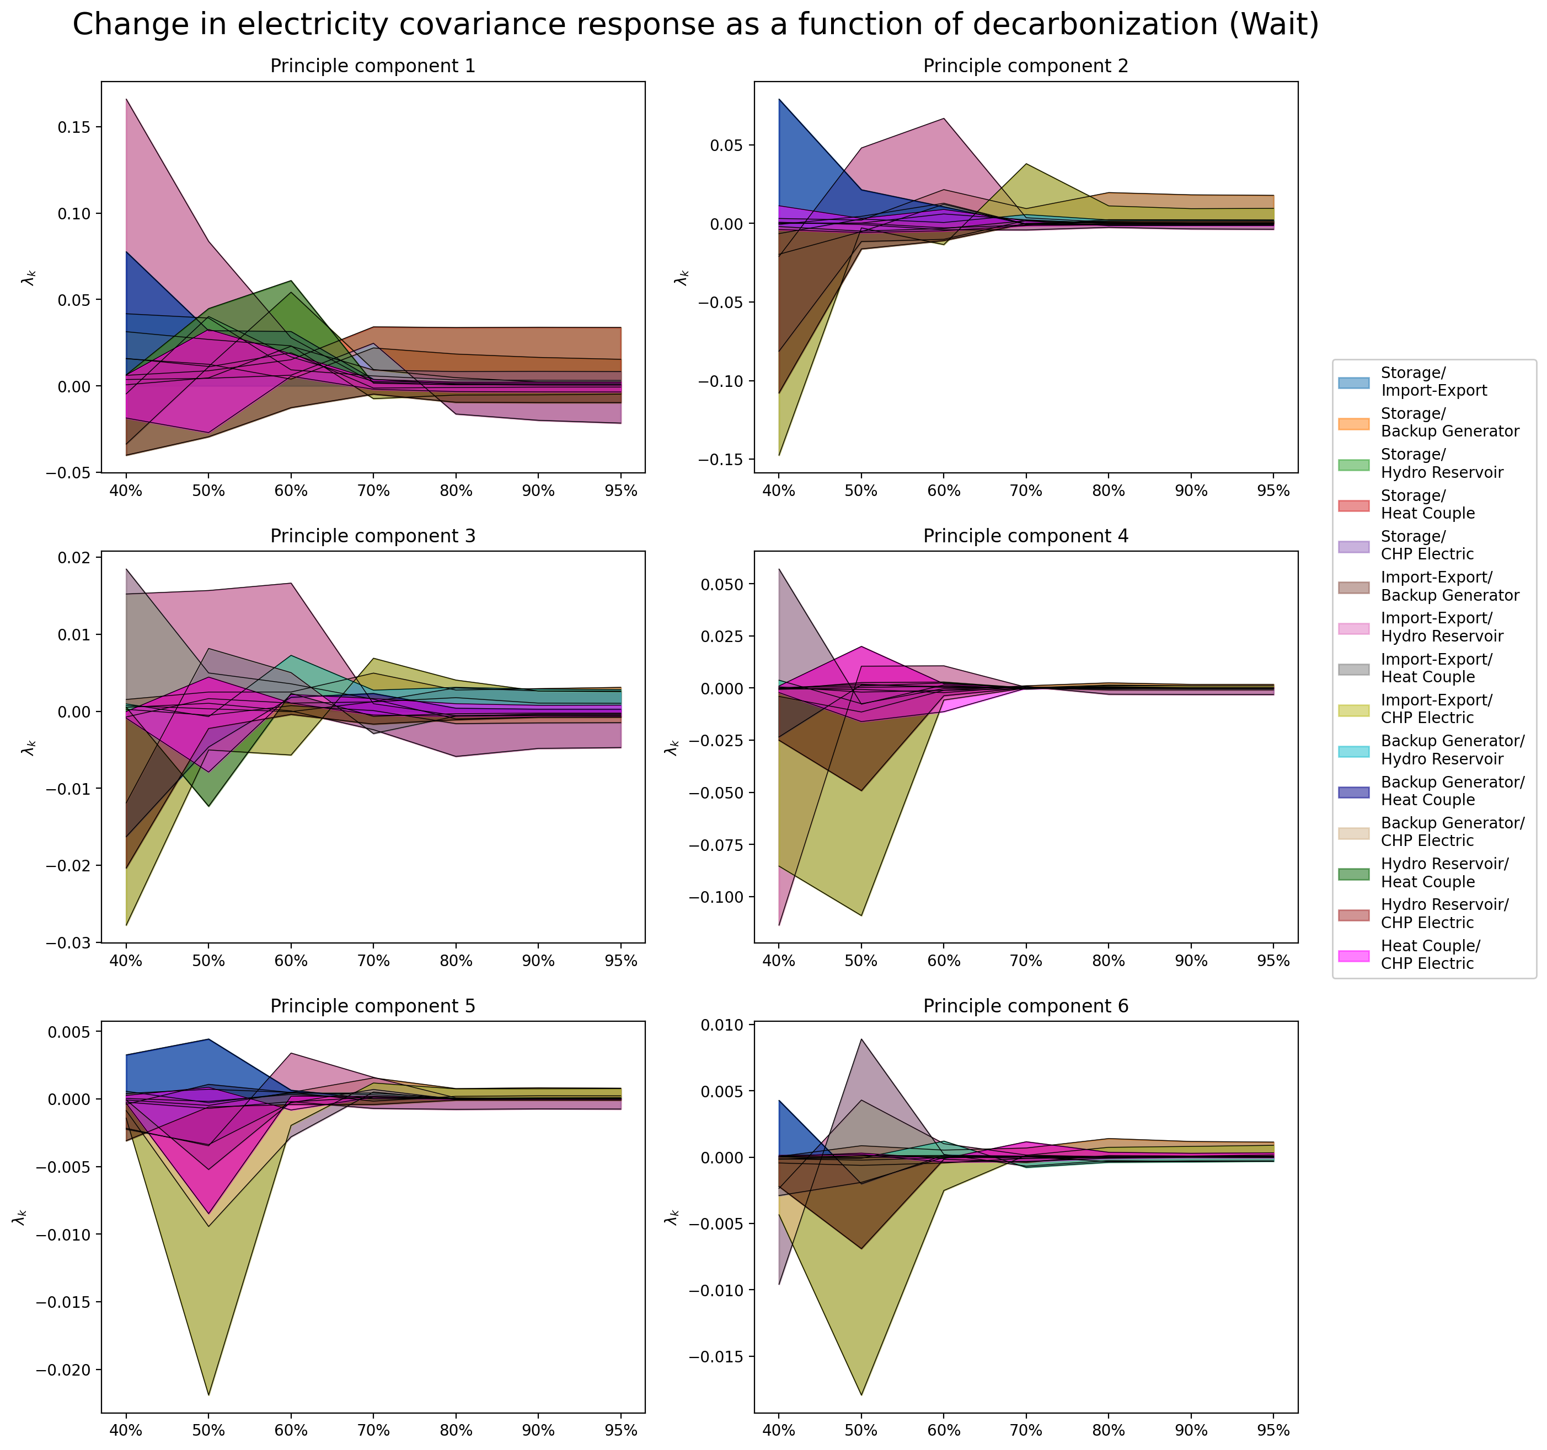
PCA – Change in Response (covariance terms)

Slide 12
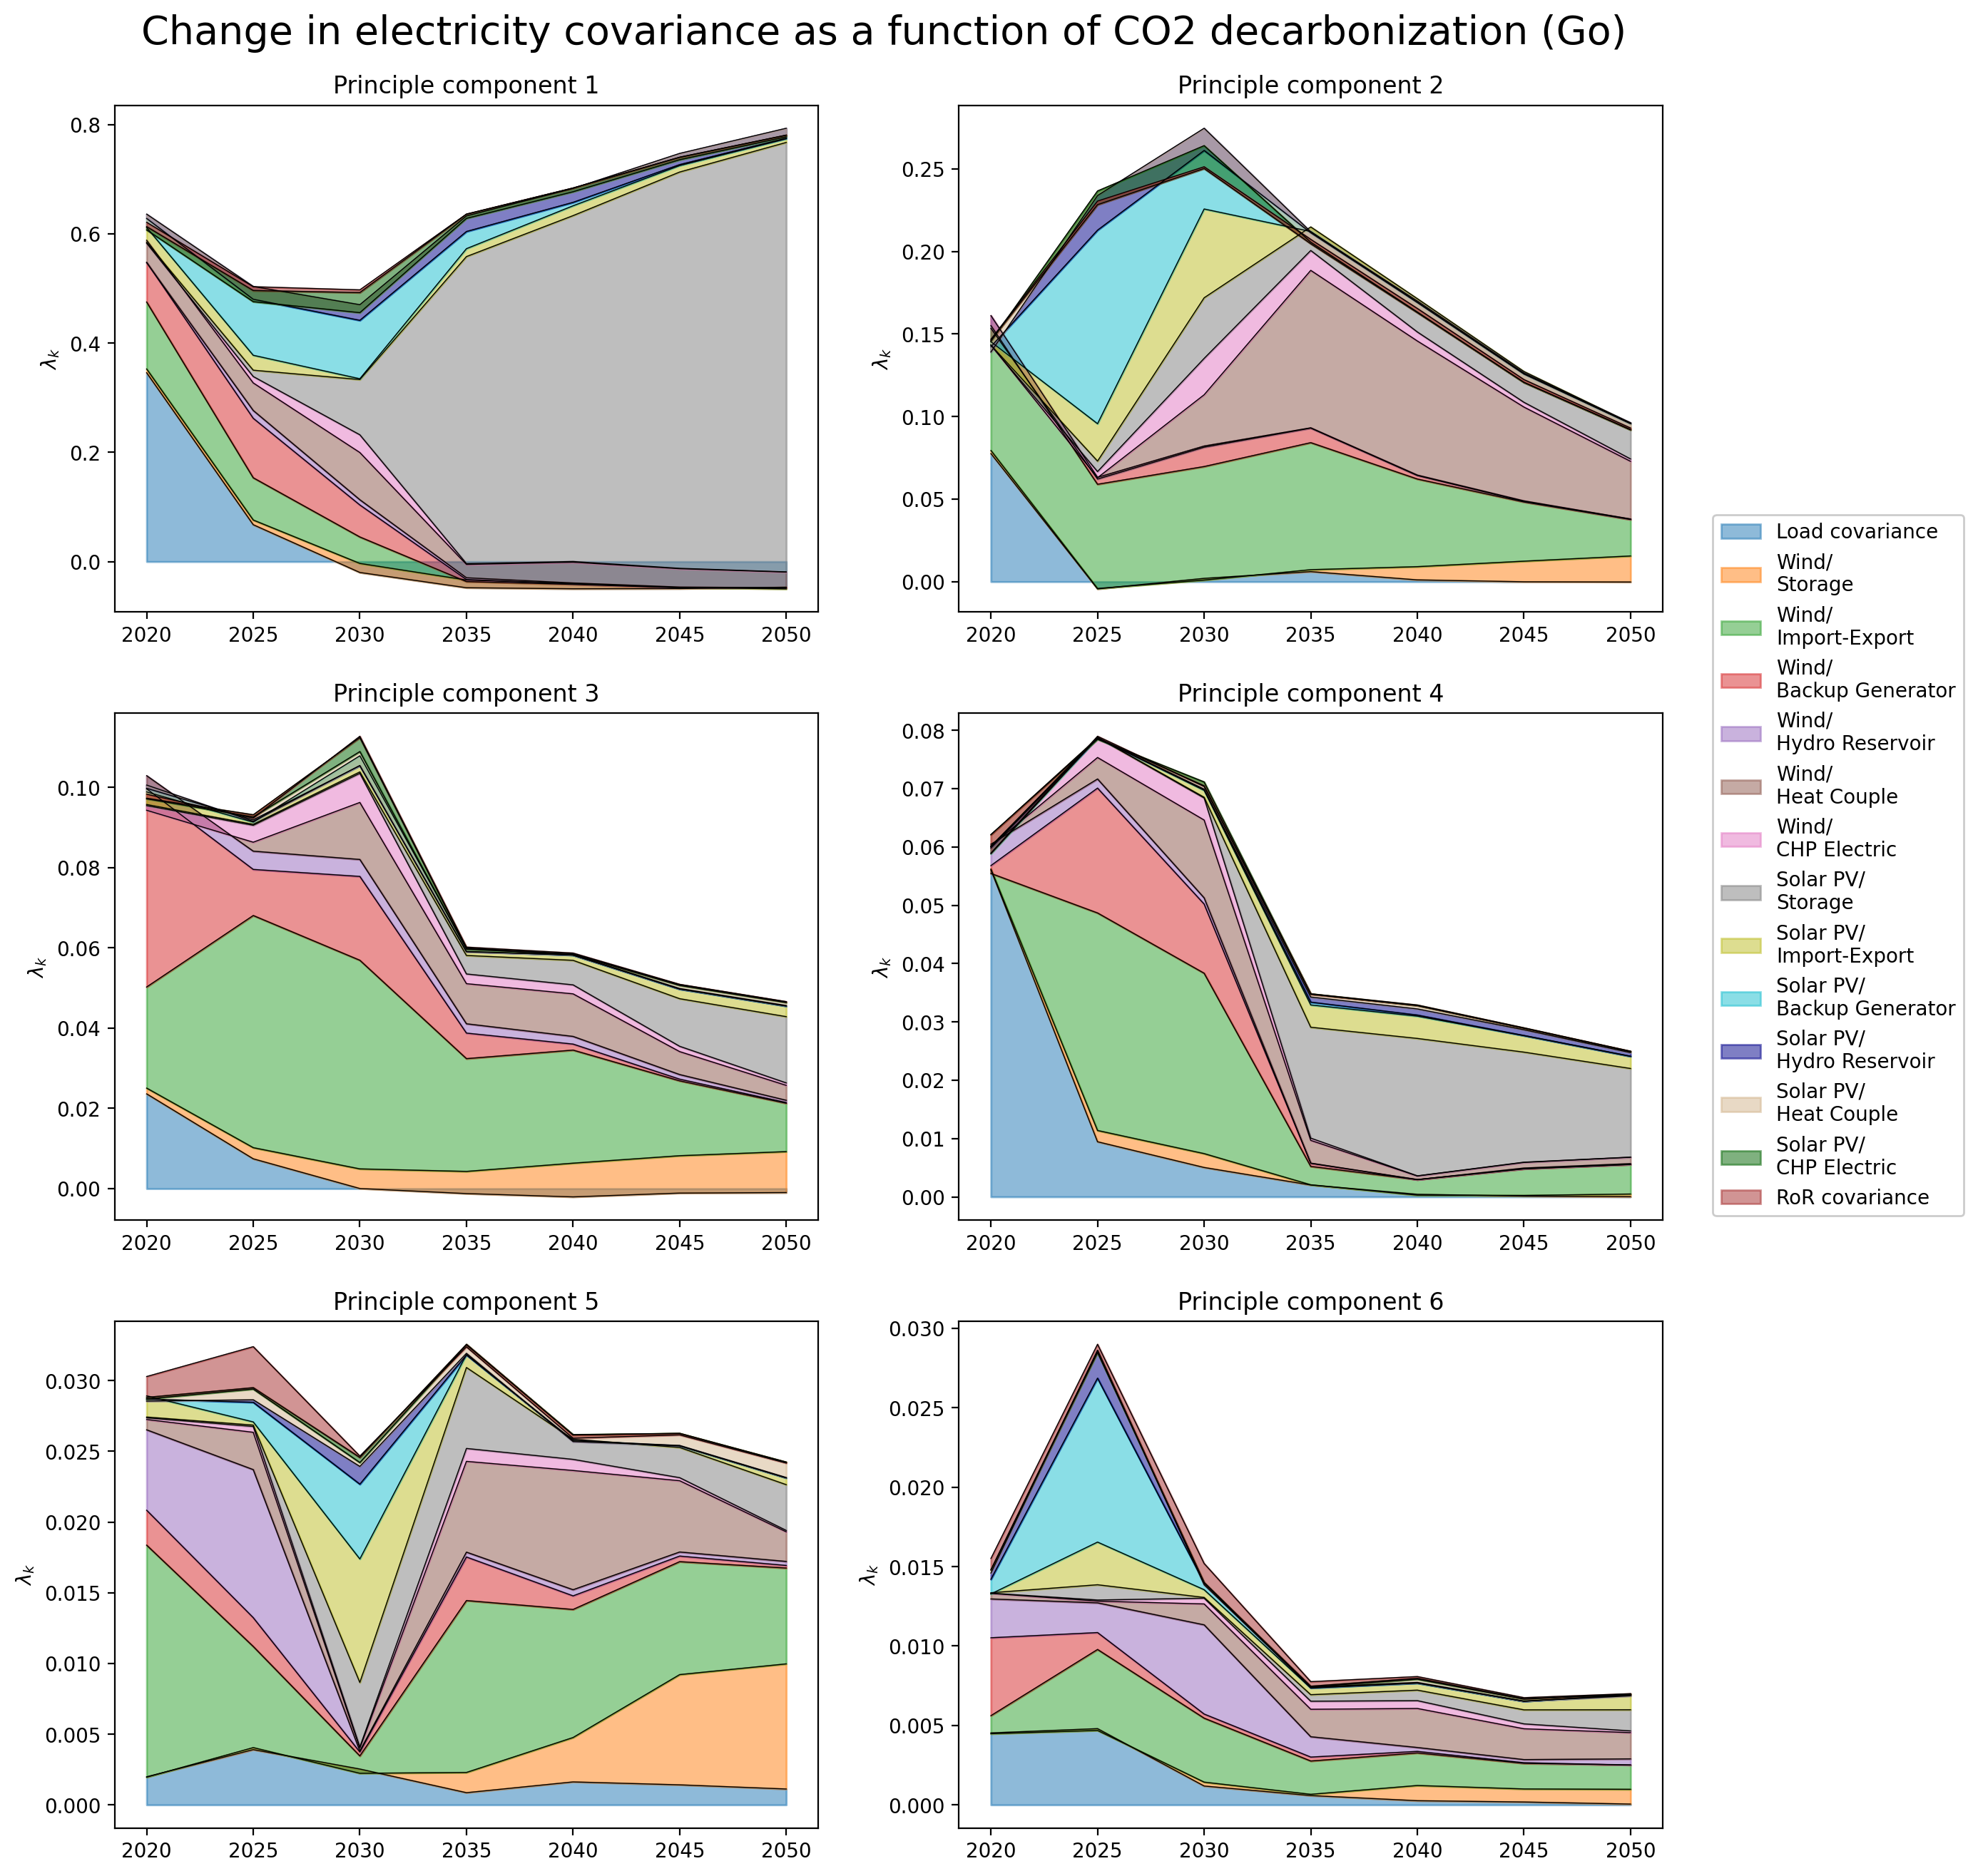
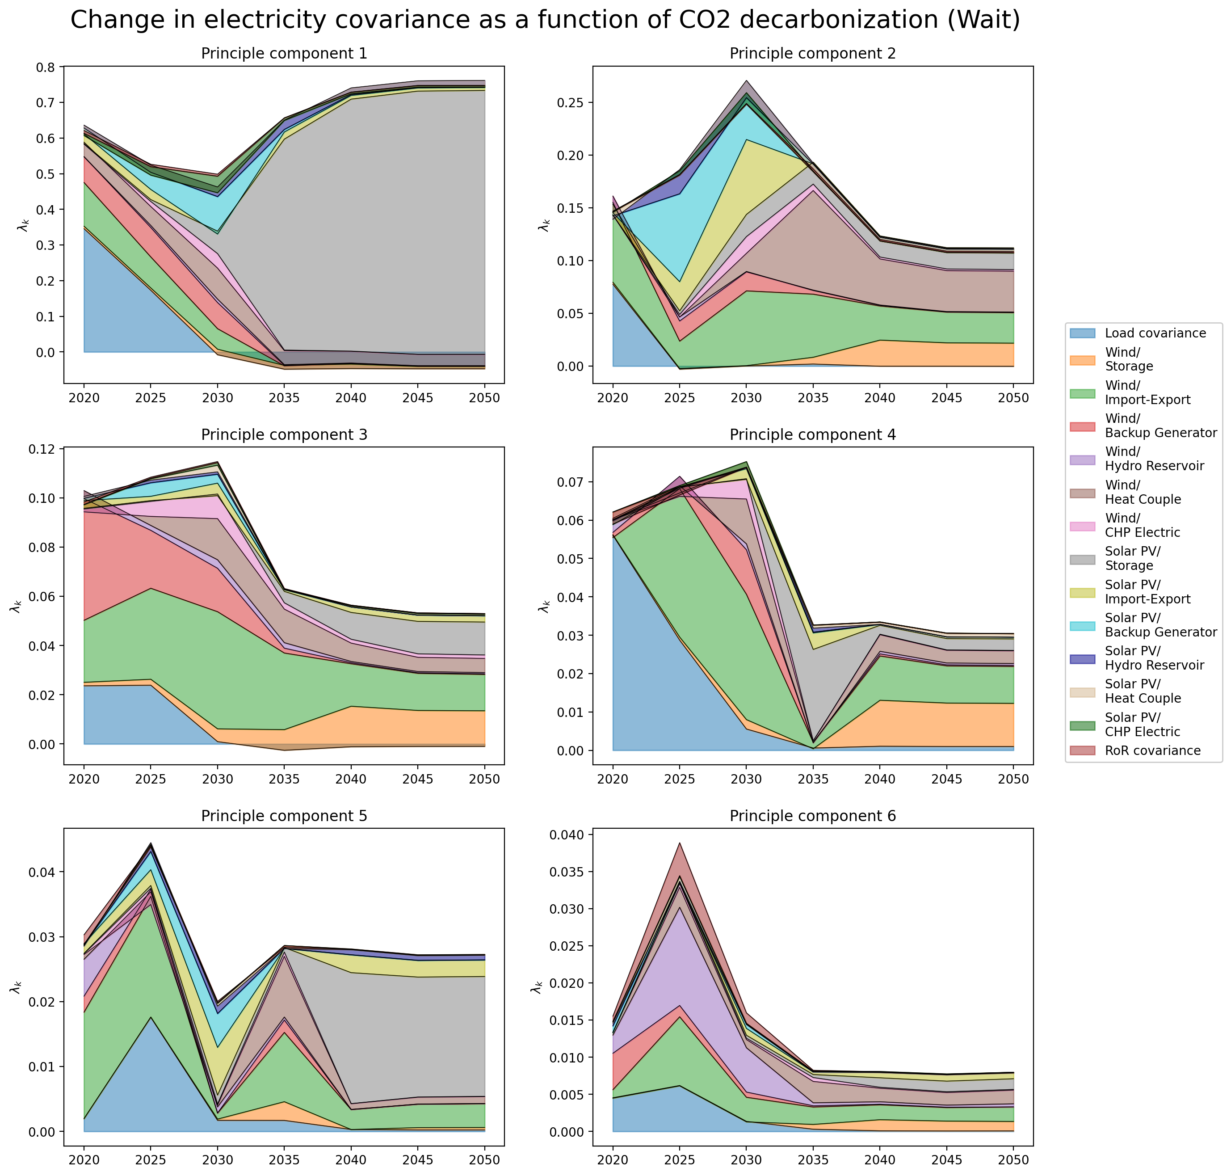
PCA – Change in Covariance

Slide 13
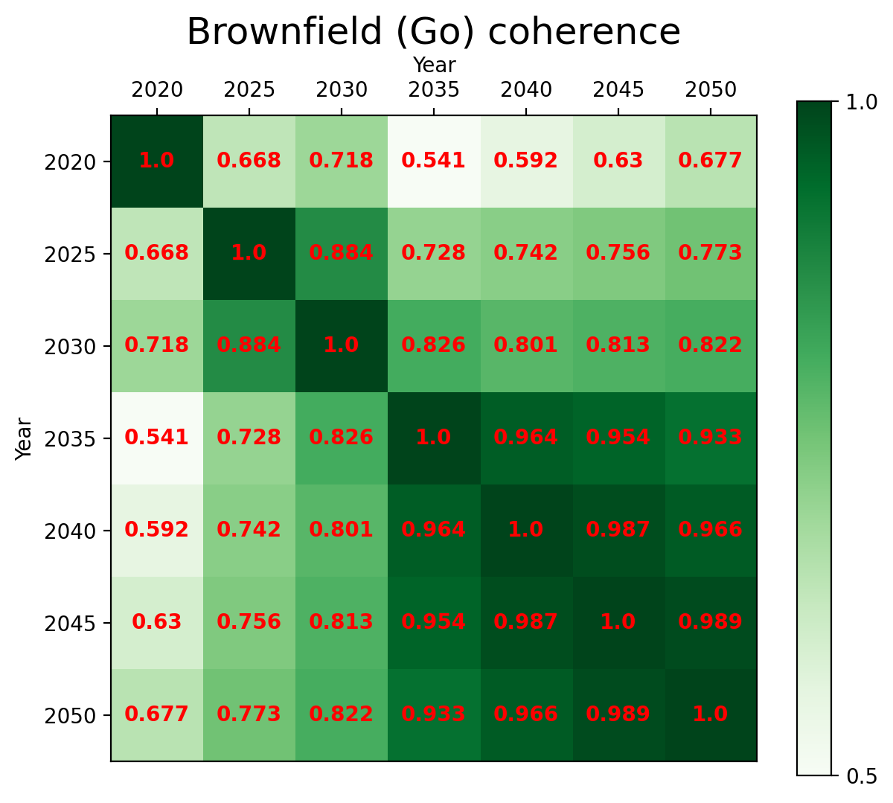
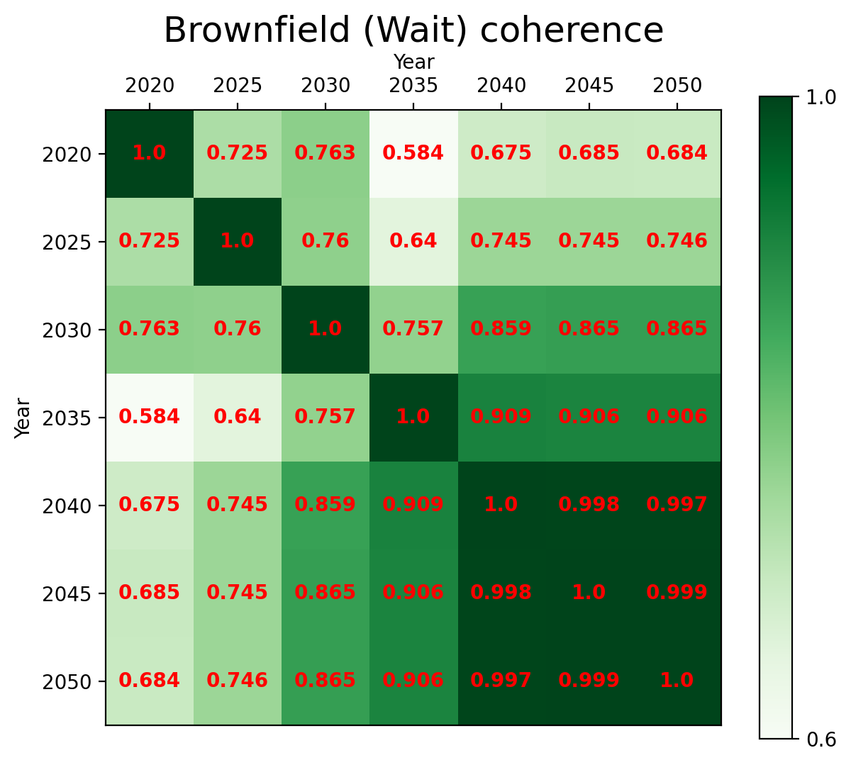
Coherence - Between Networks
Notes:
Coherence between go and wait

Slide 14
Transition Path
Heating Mismatch Analysis

Slide 15
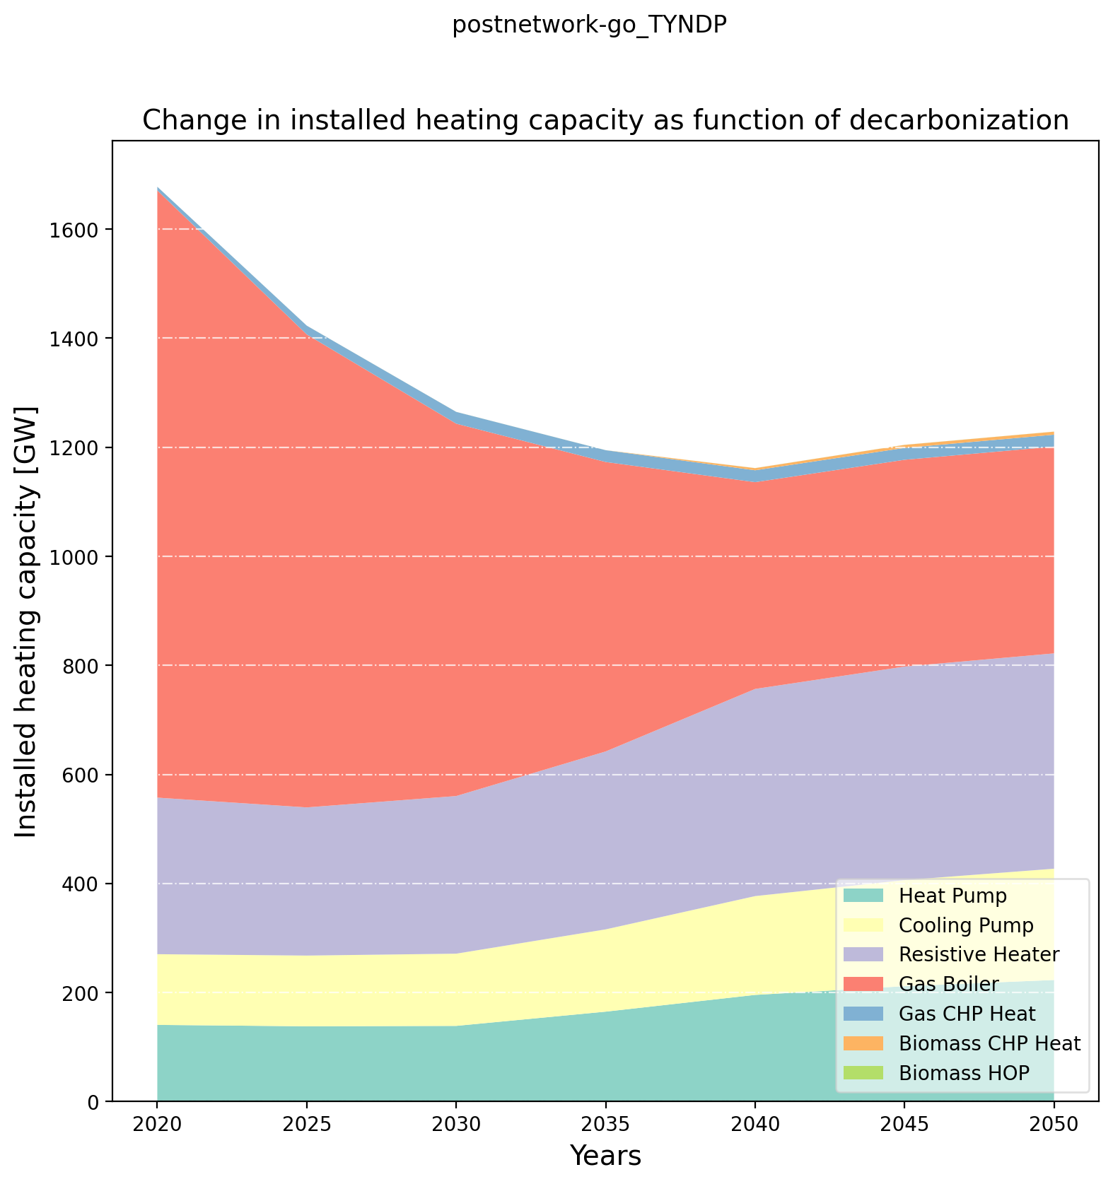
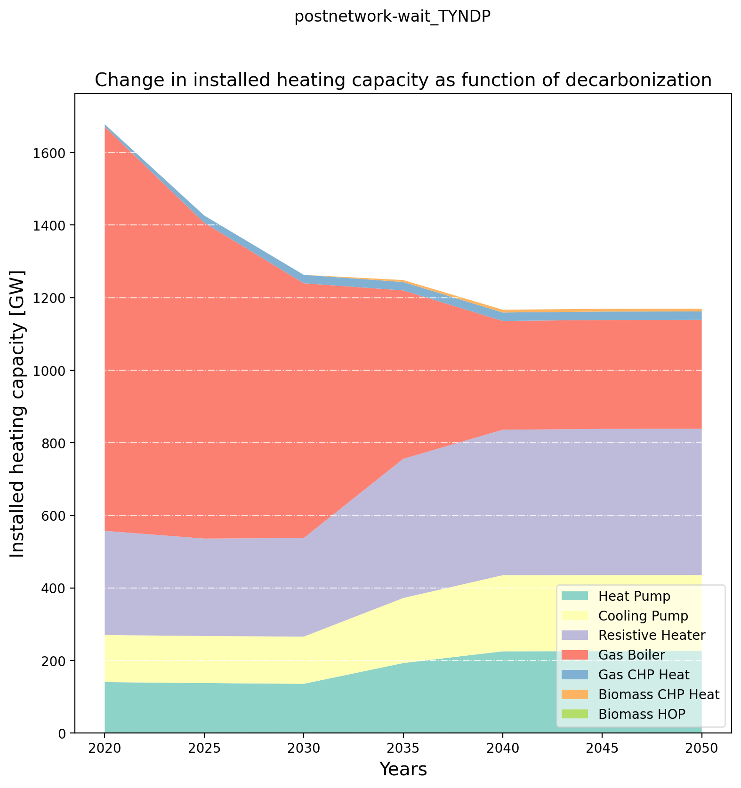
Pre-analysis – Heating Installed Capacity

Slide 16
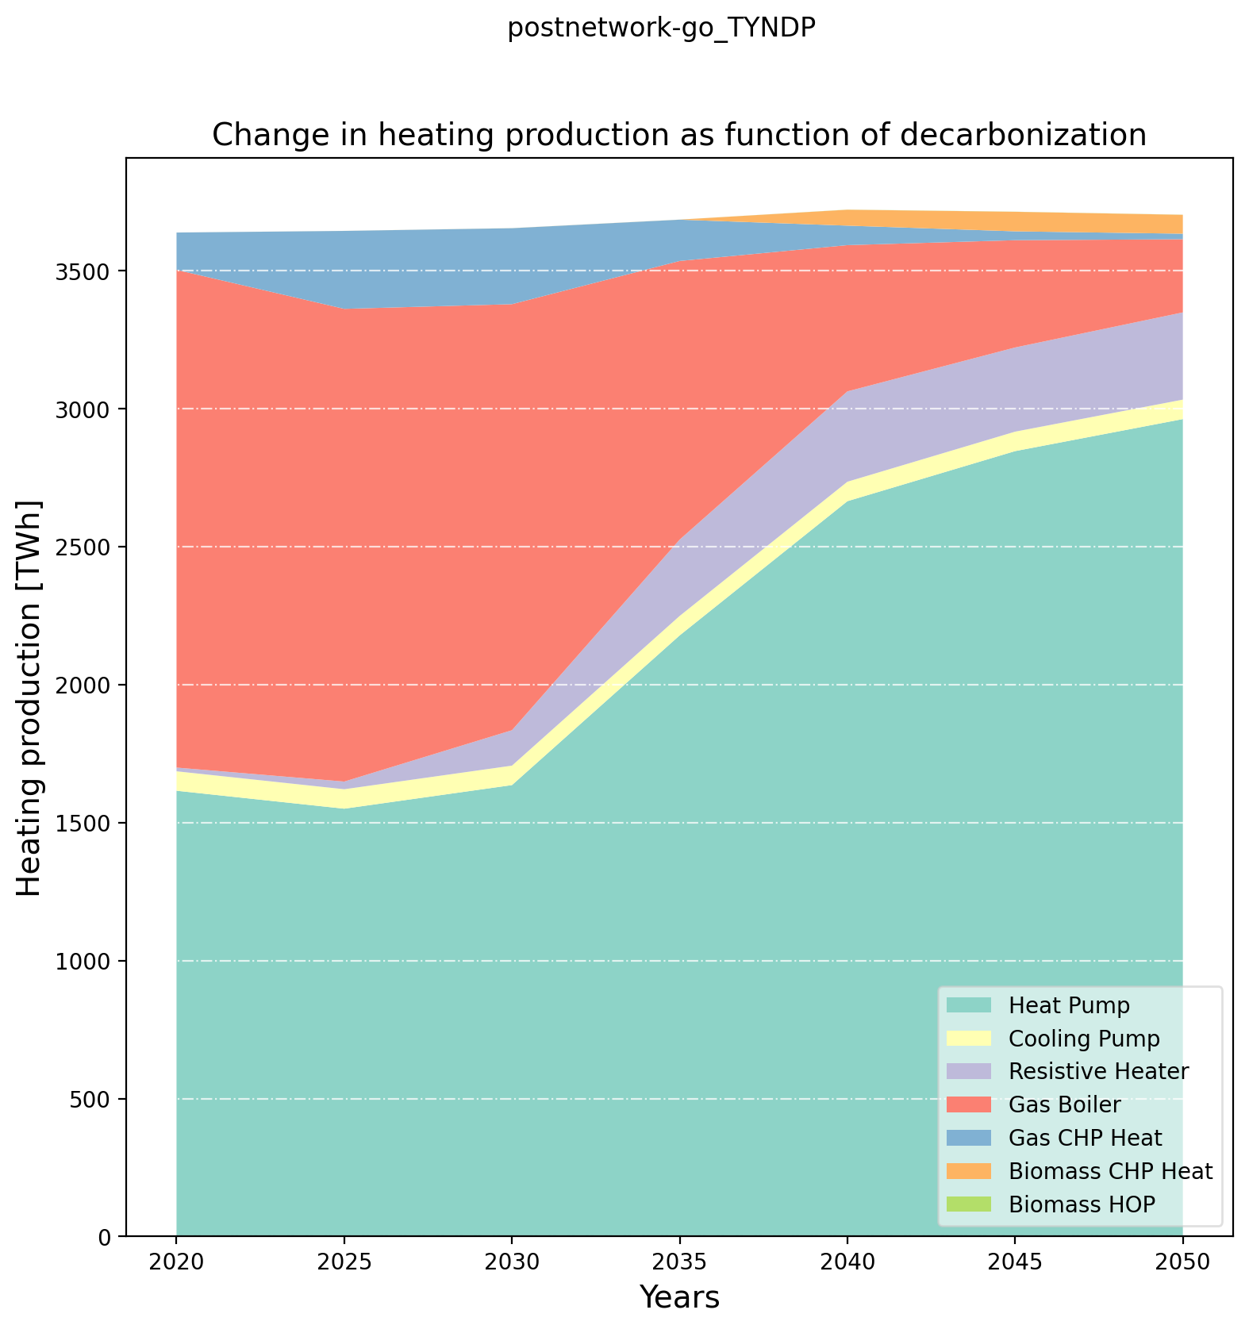
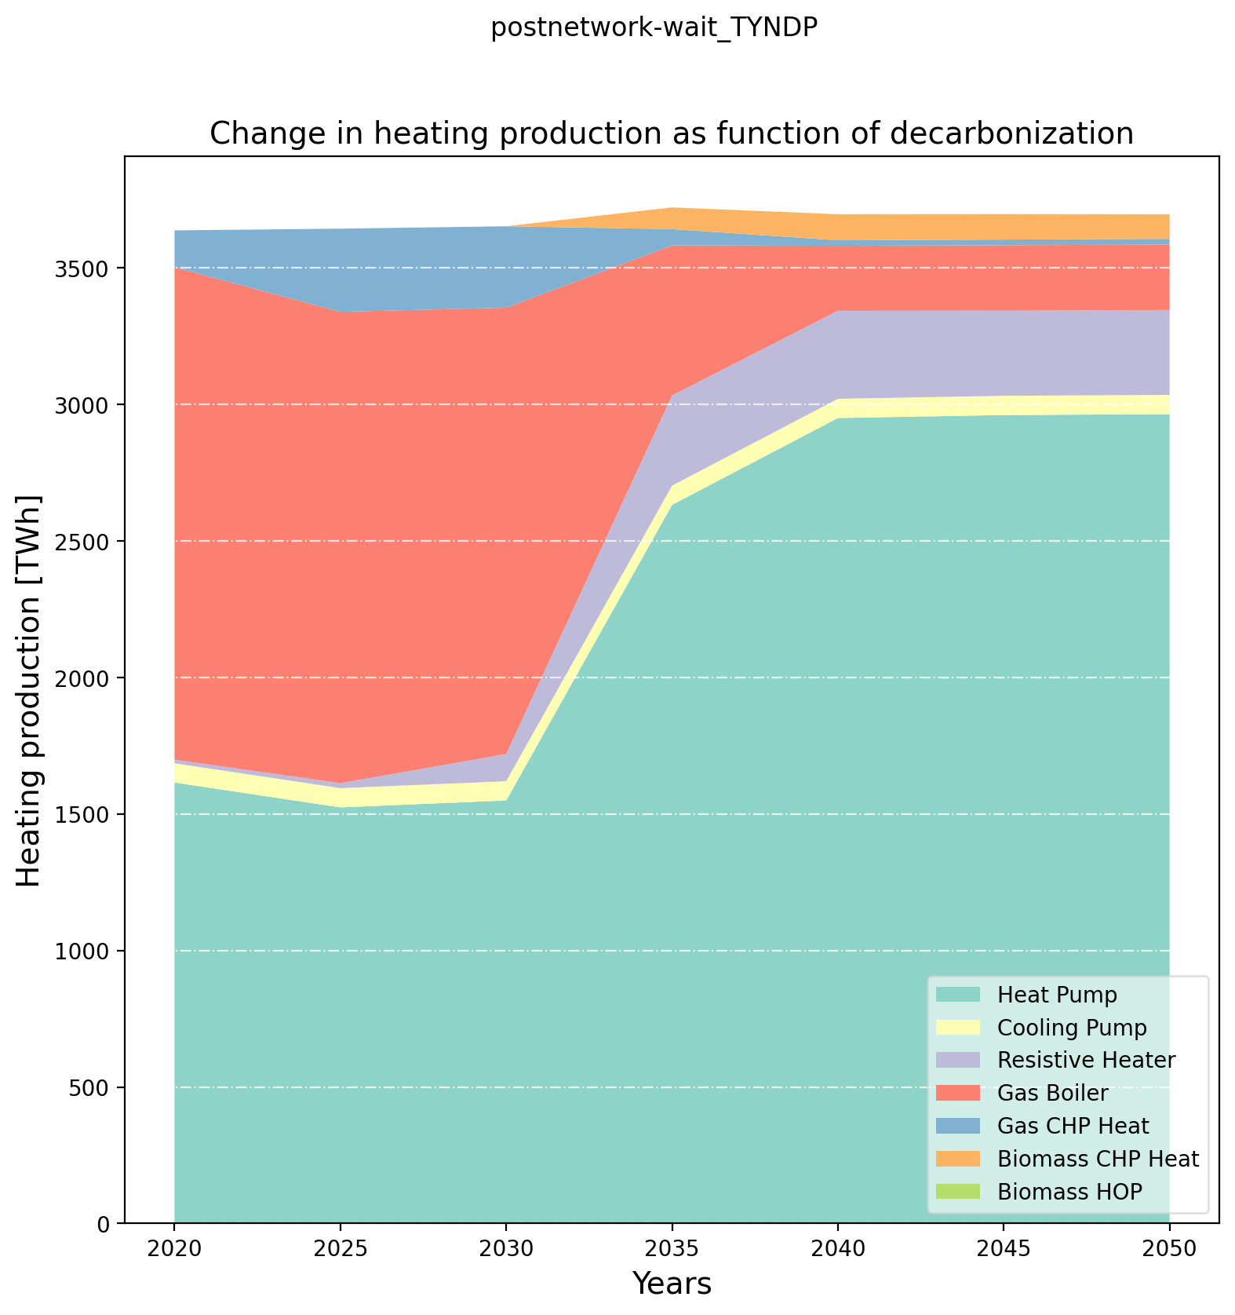
Pre-analysis – Heating Production

Slide 17
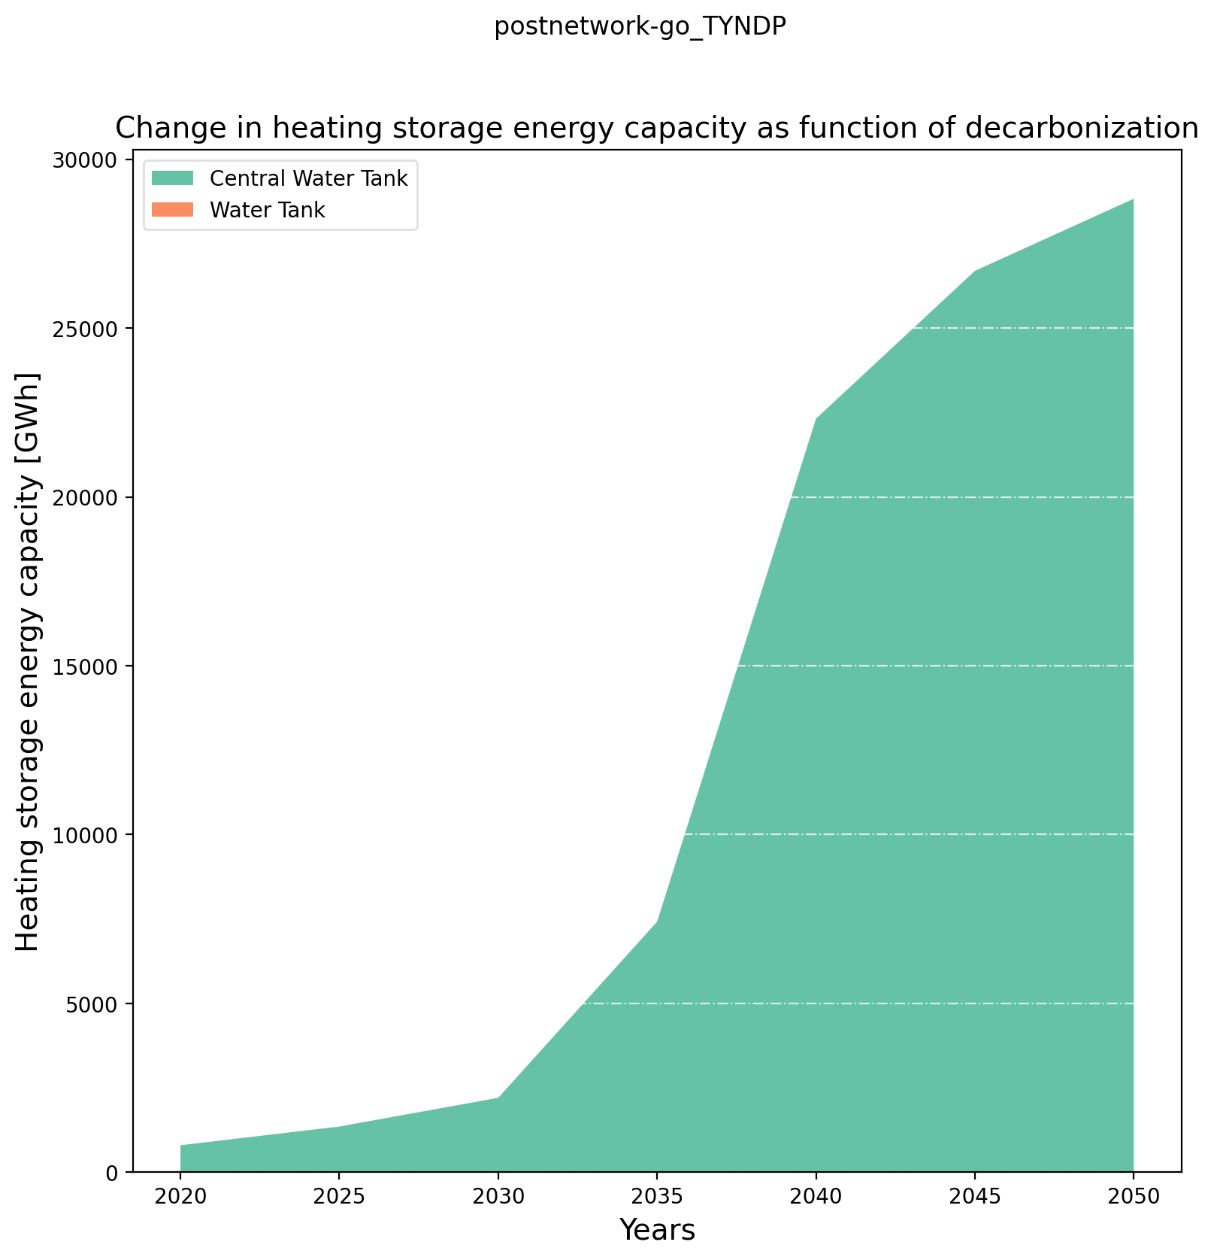
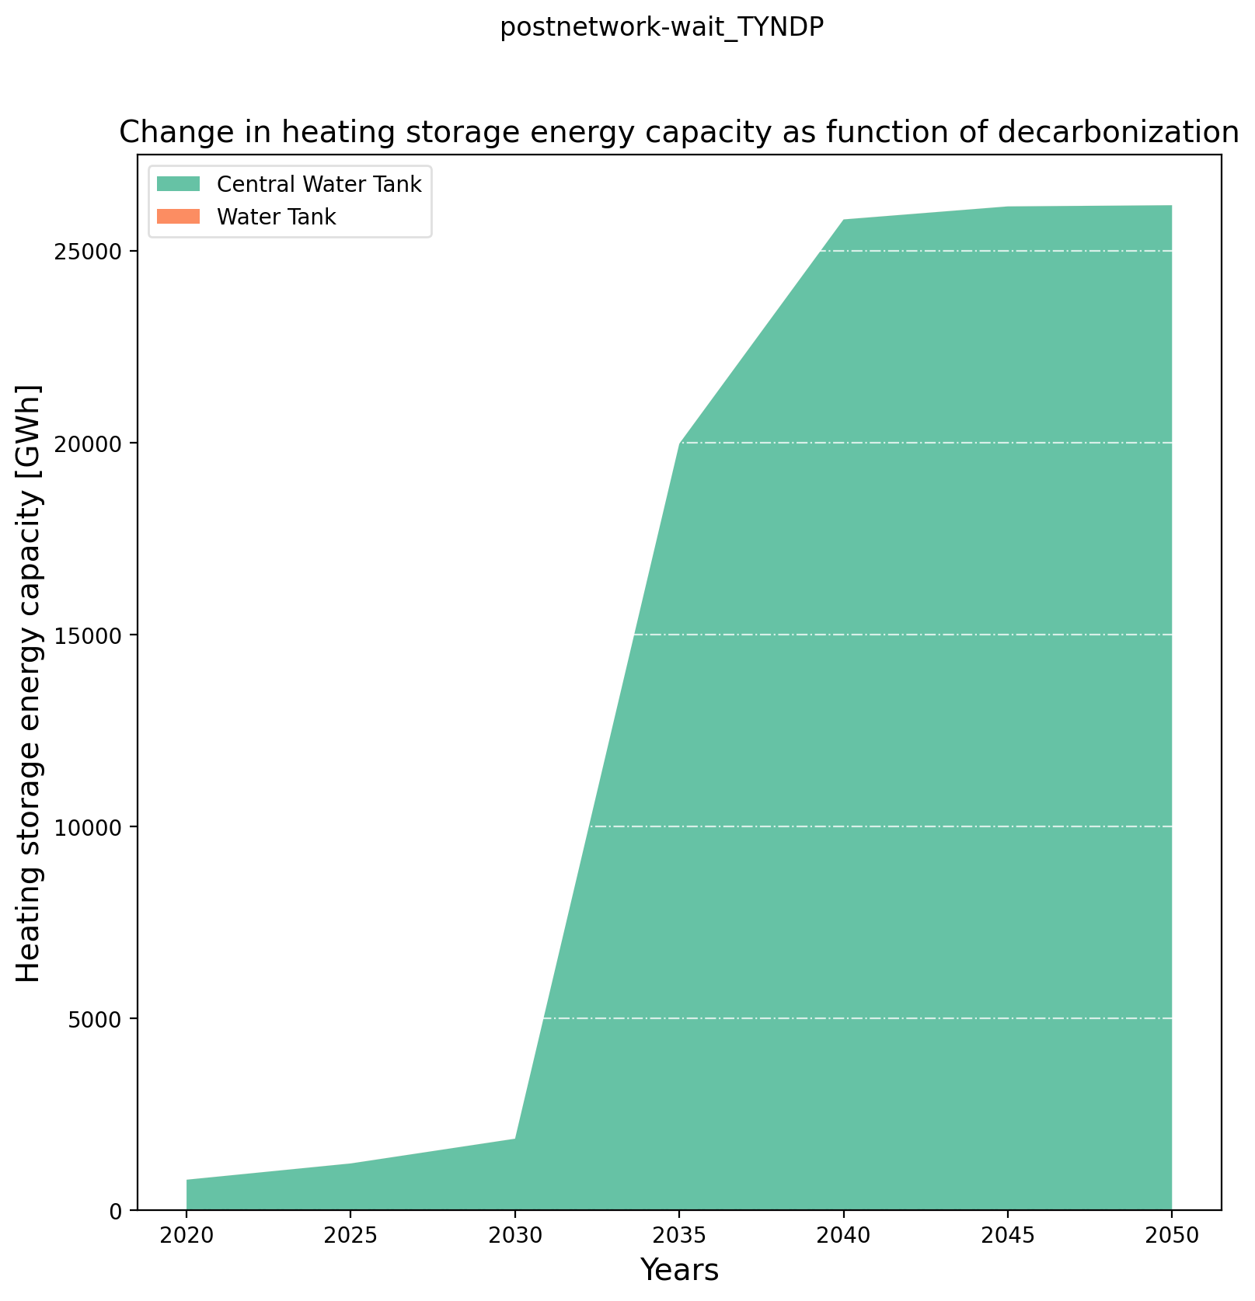
Pre-analysis – Heating Storage Installed Capacity

Slide 18
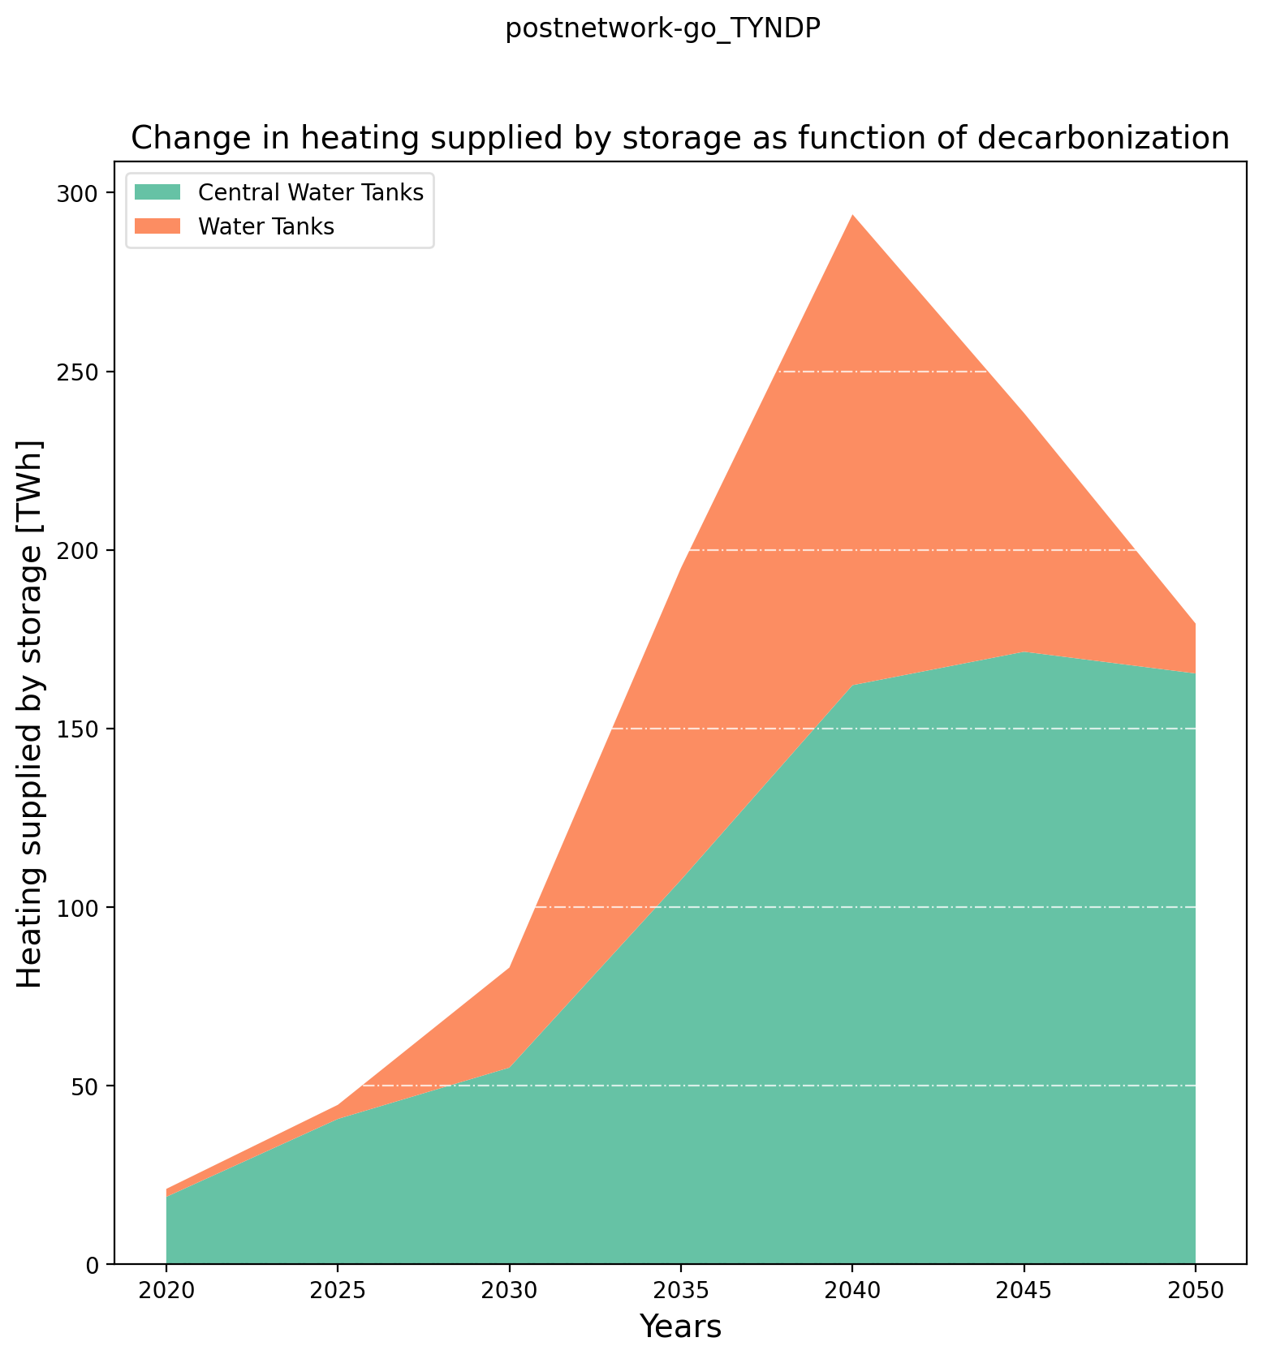
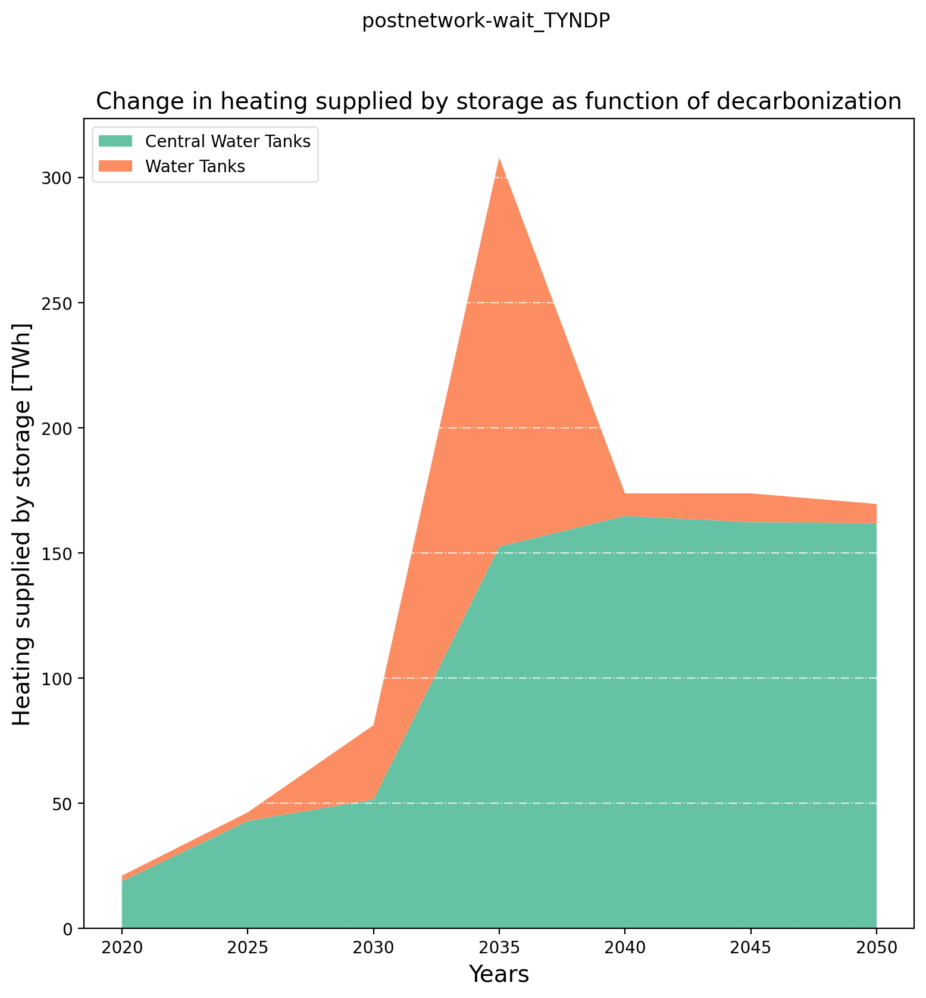
Pre-analysis – Heating Storage Production

Slide 19
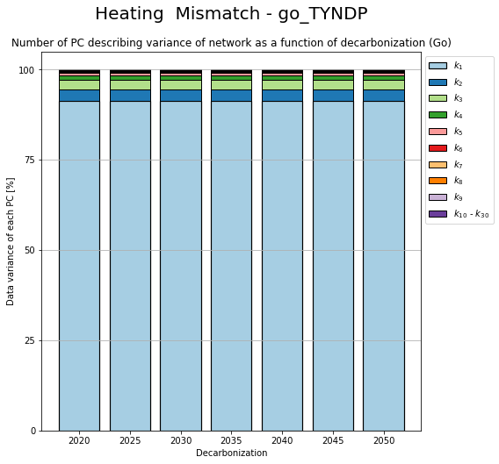

PCA – Change in components

Slide 20
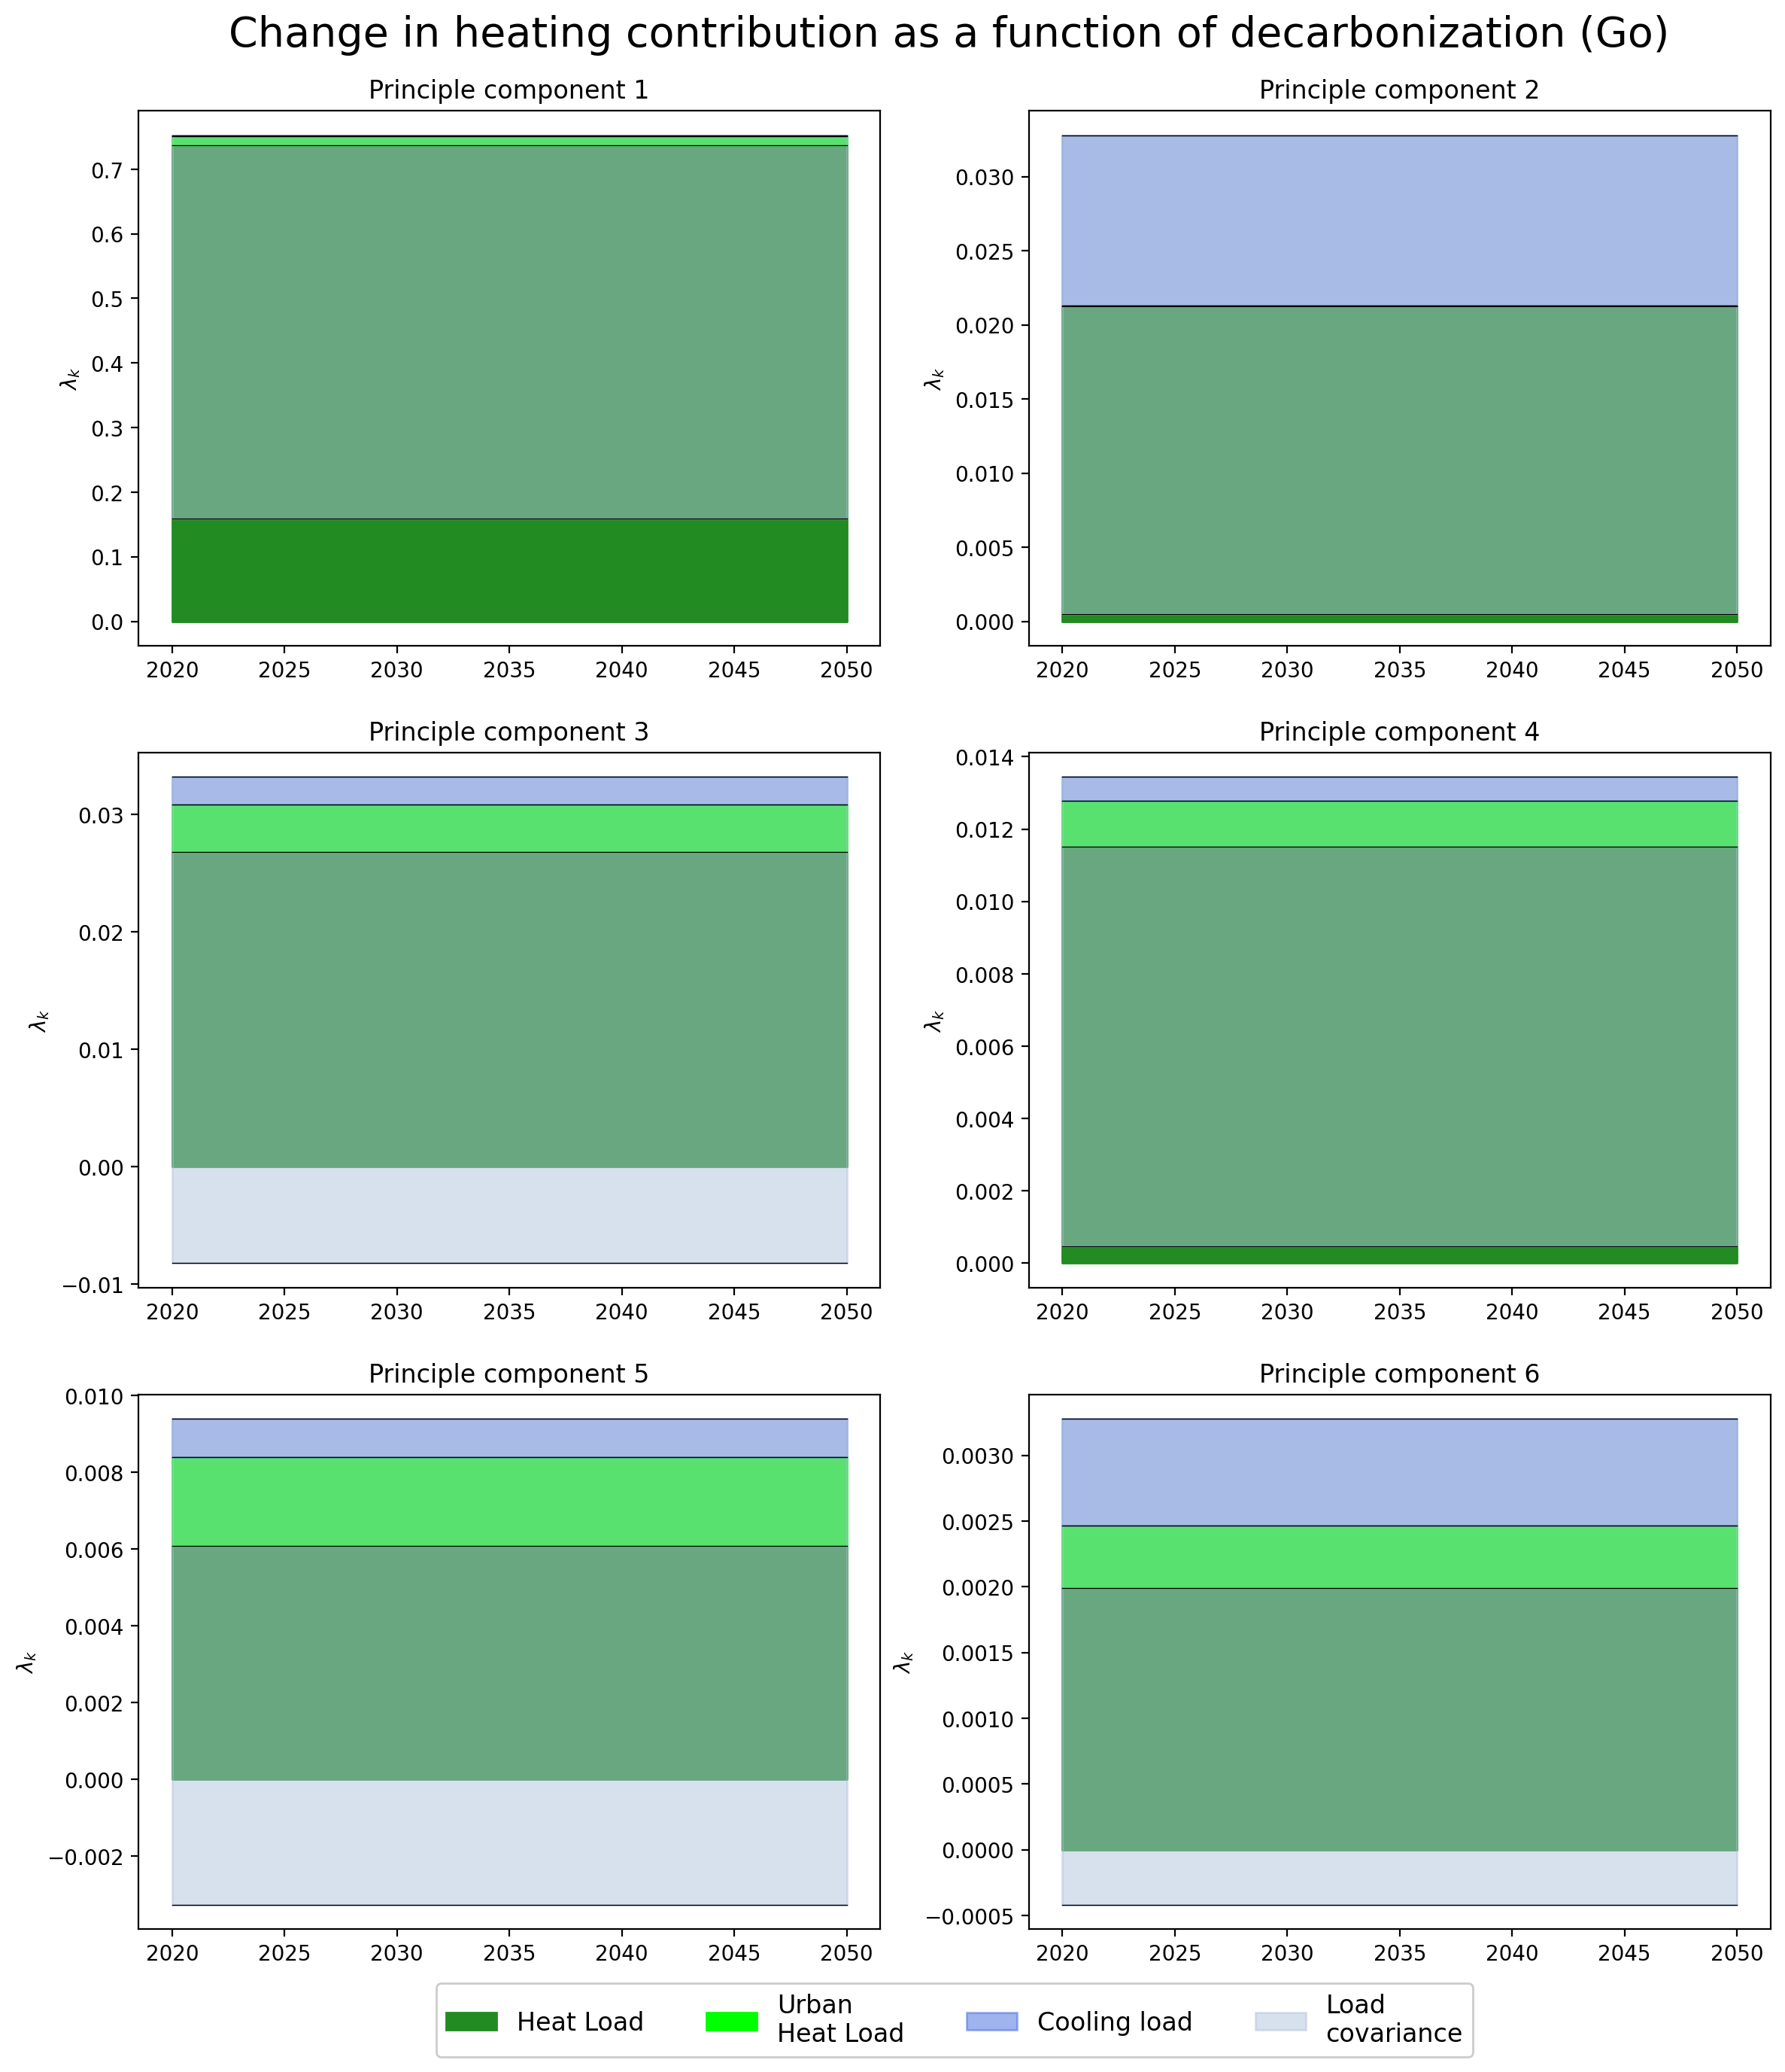

PCA – Change in Contribution

Slide 21
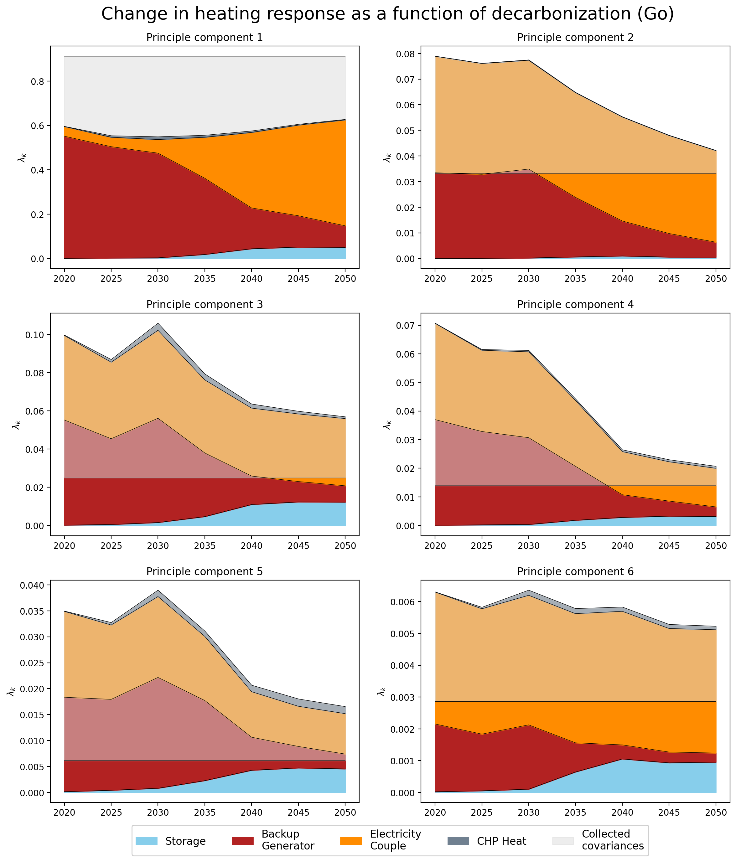
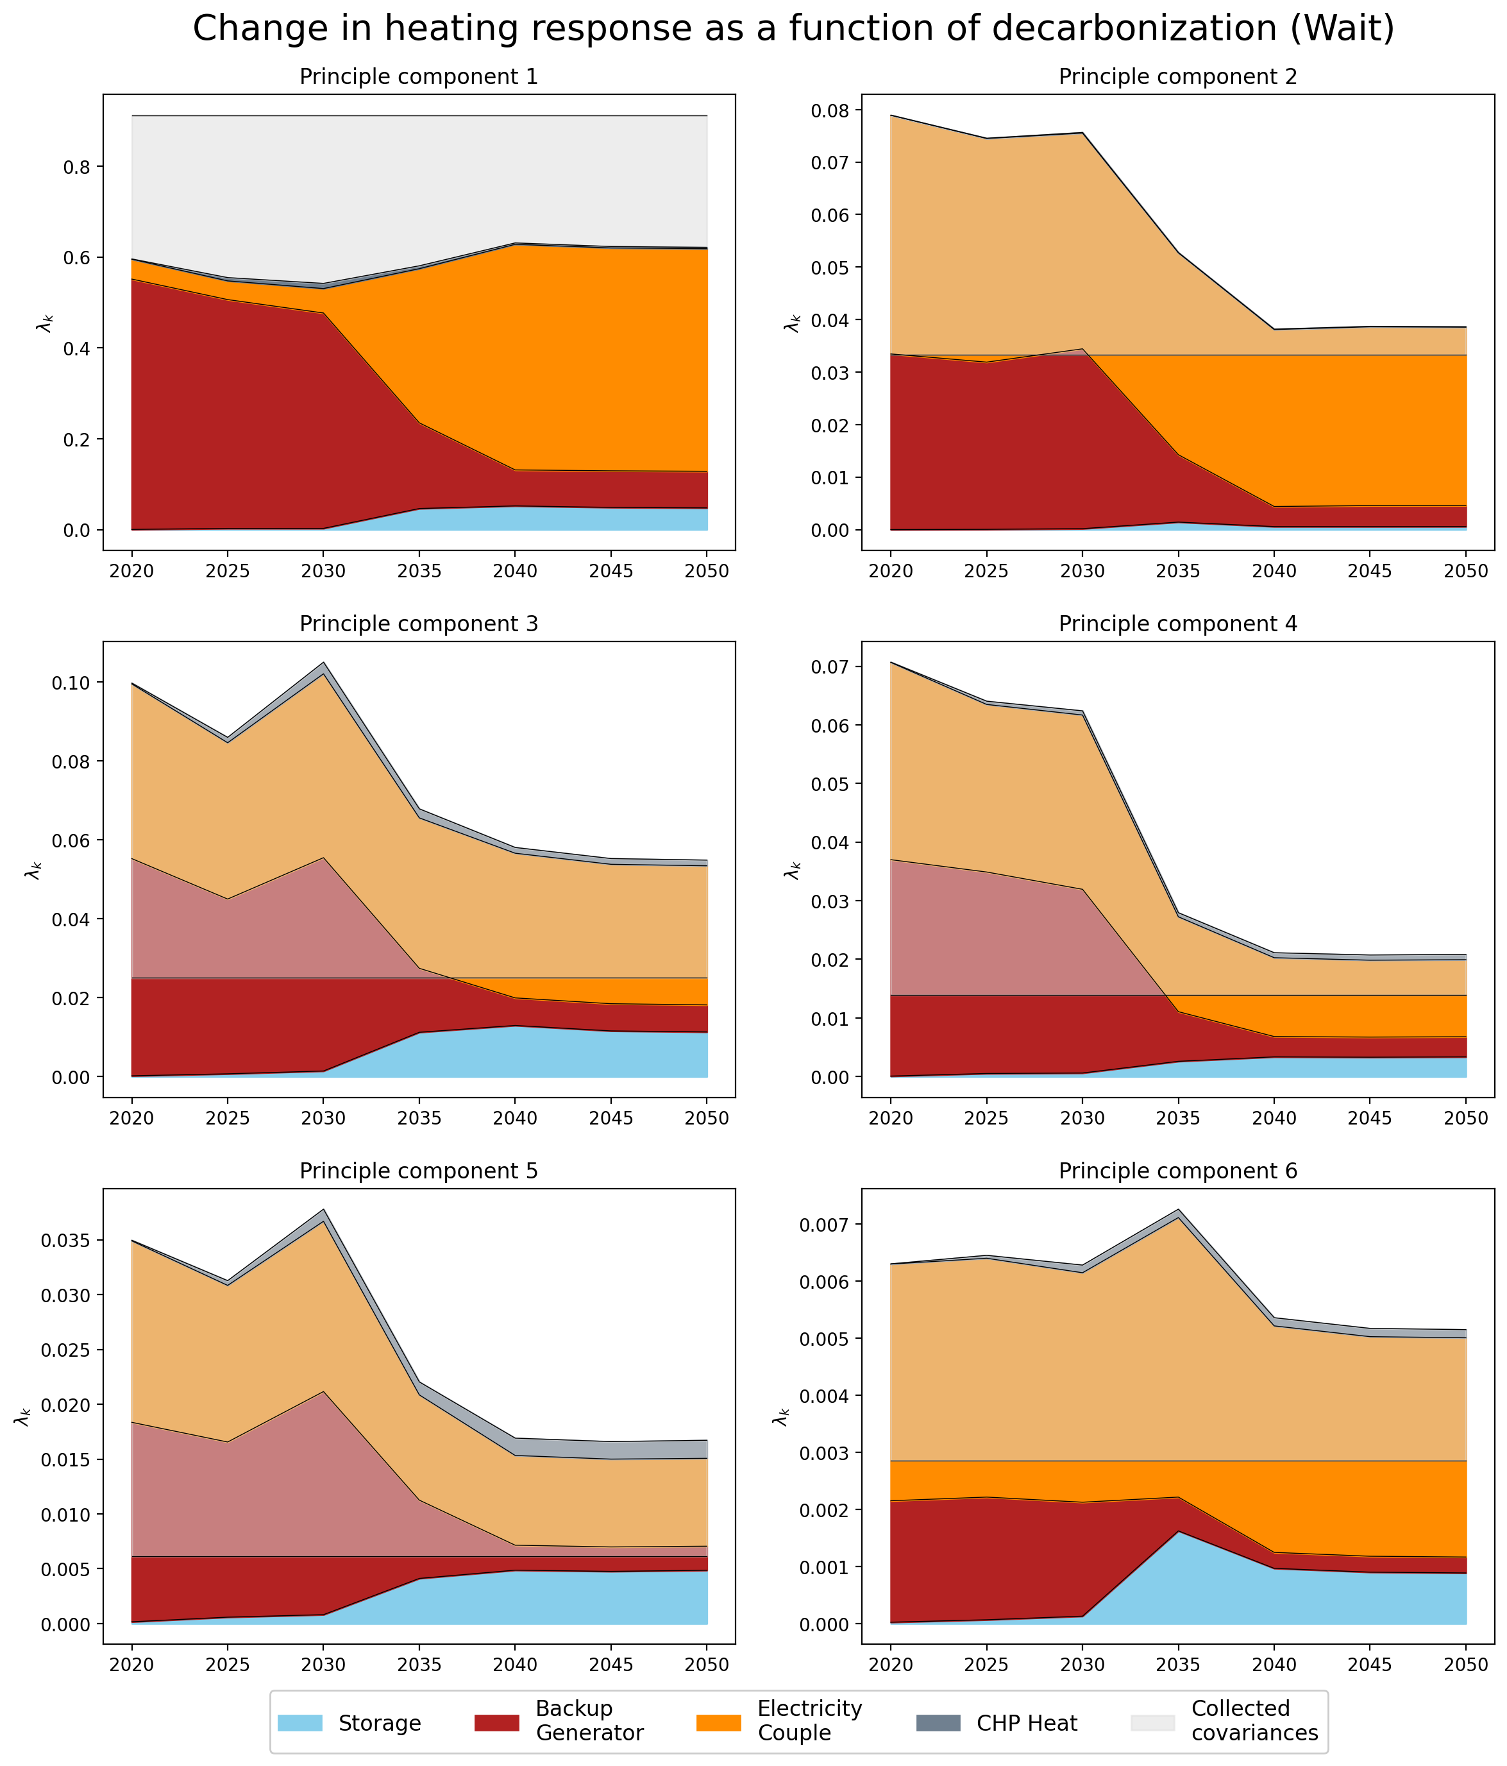
PCA – Change in Response

Slide 22
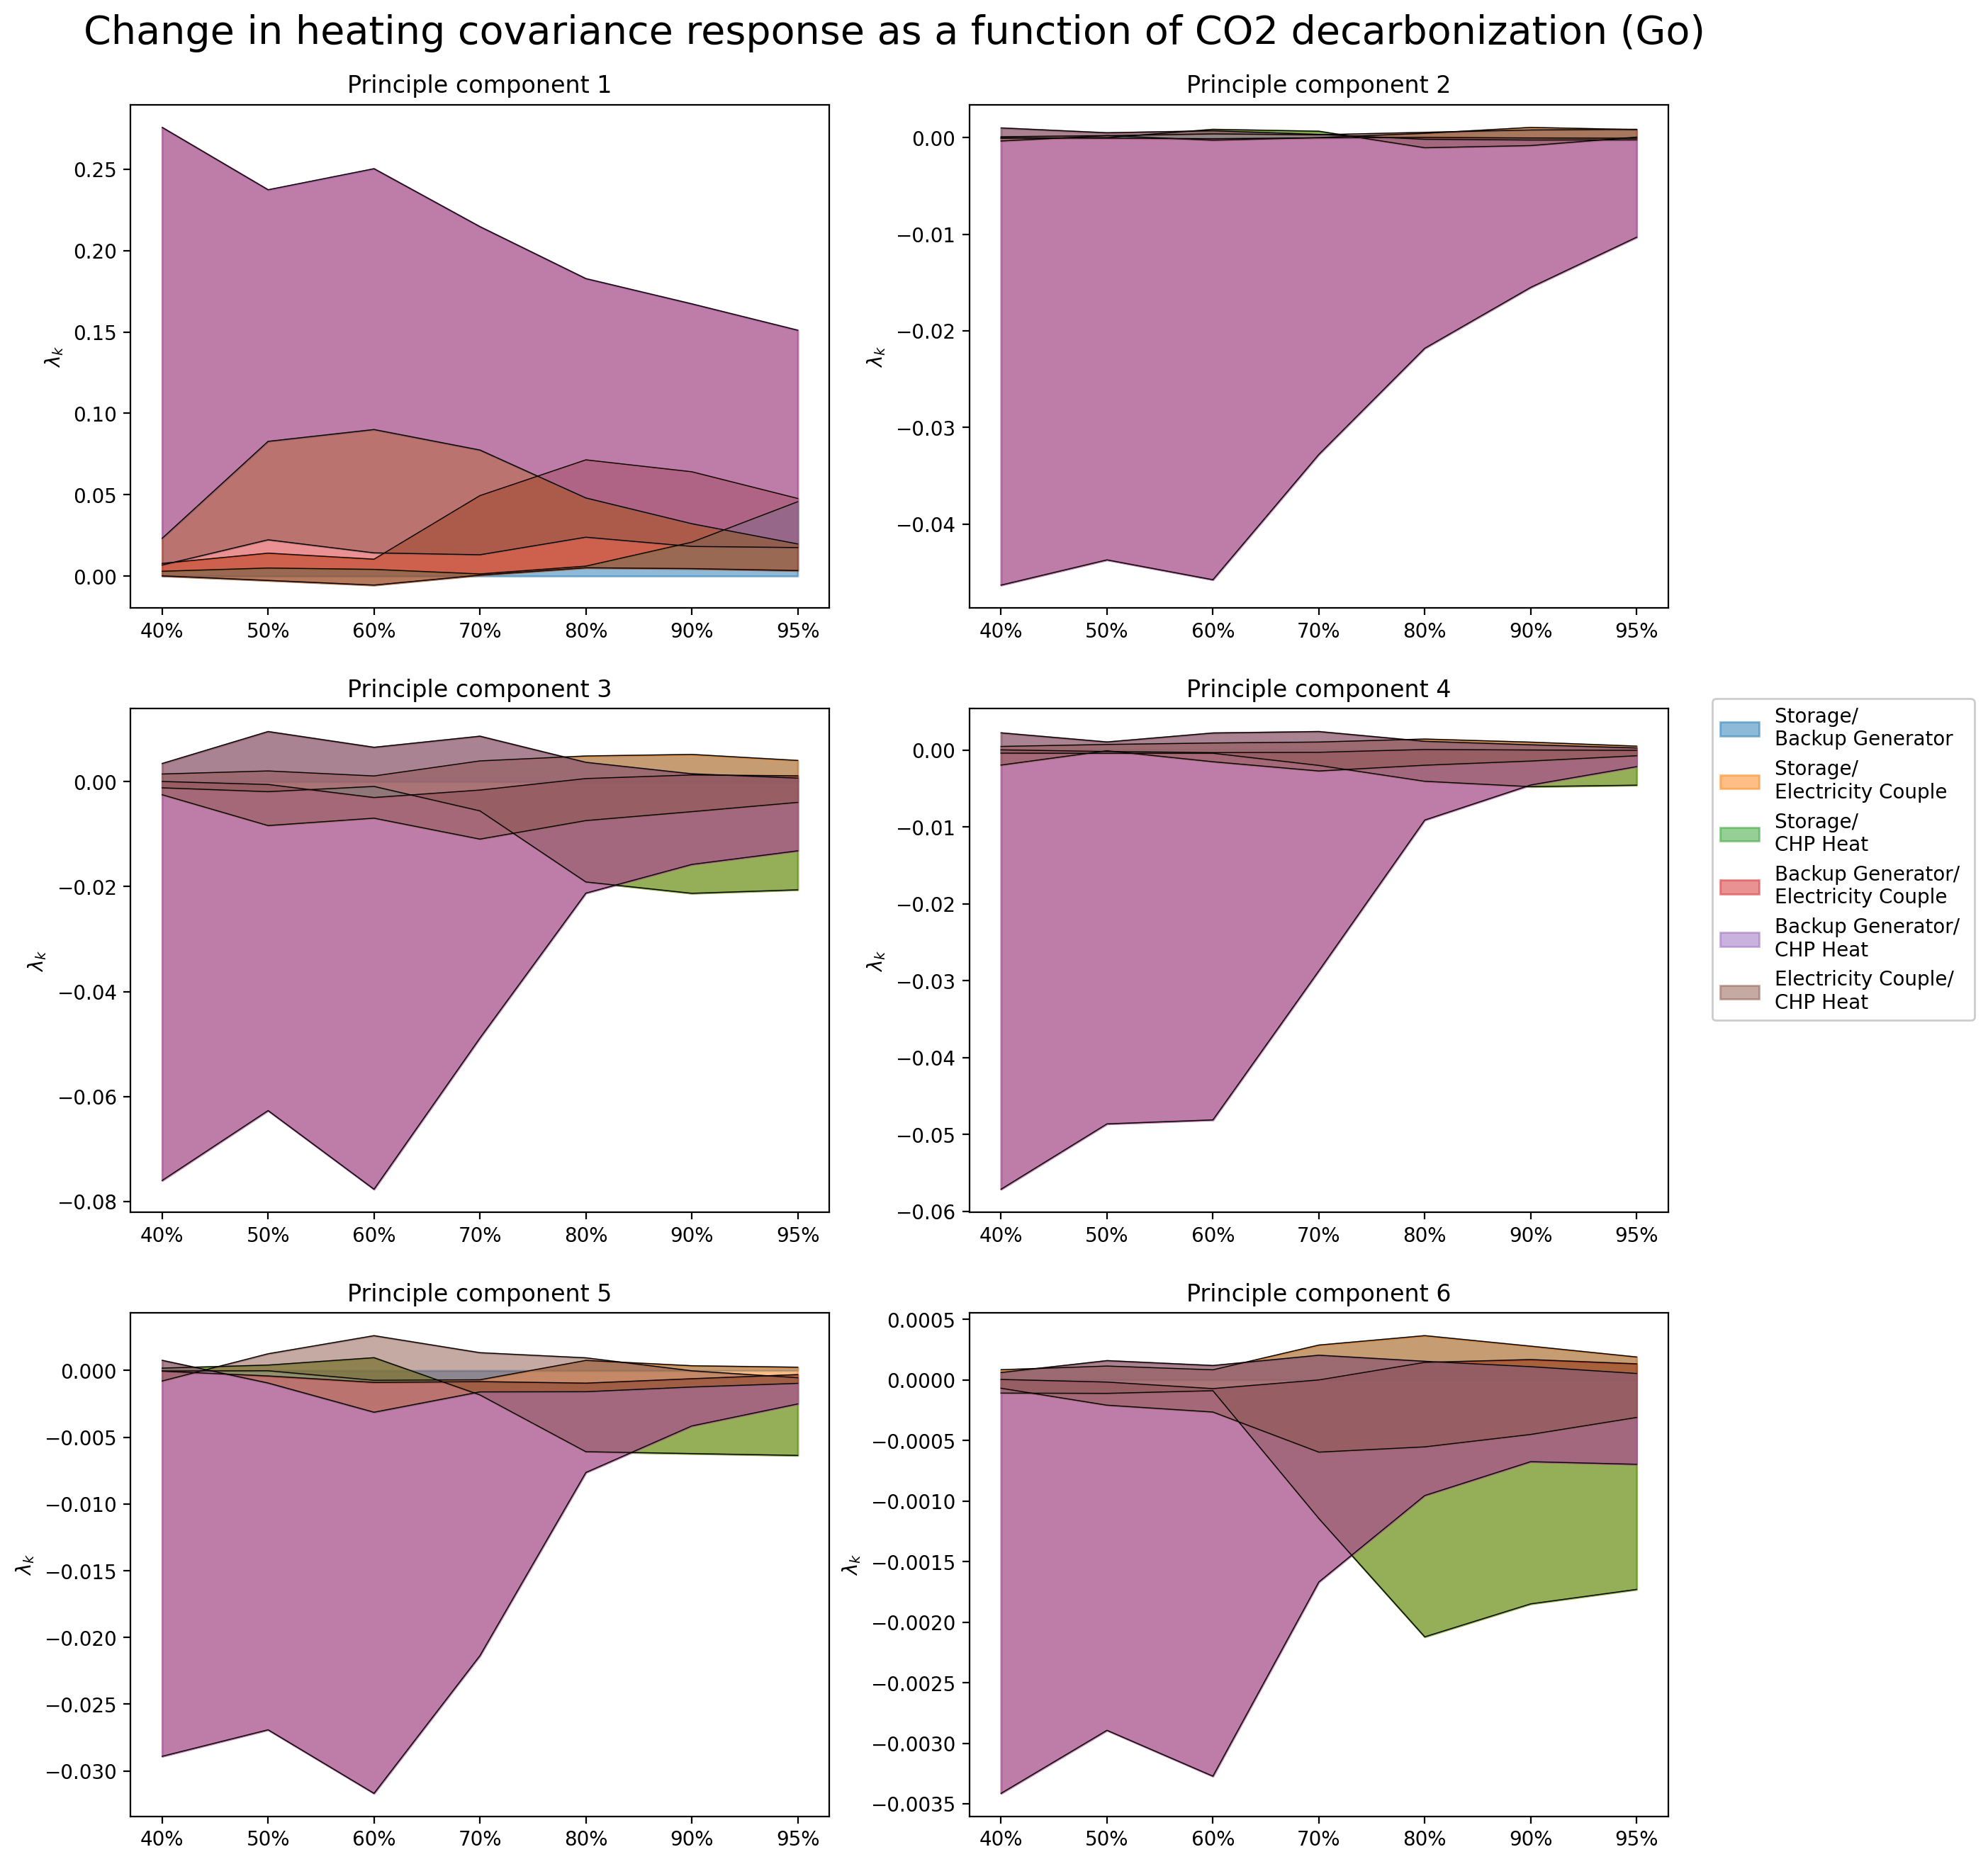
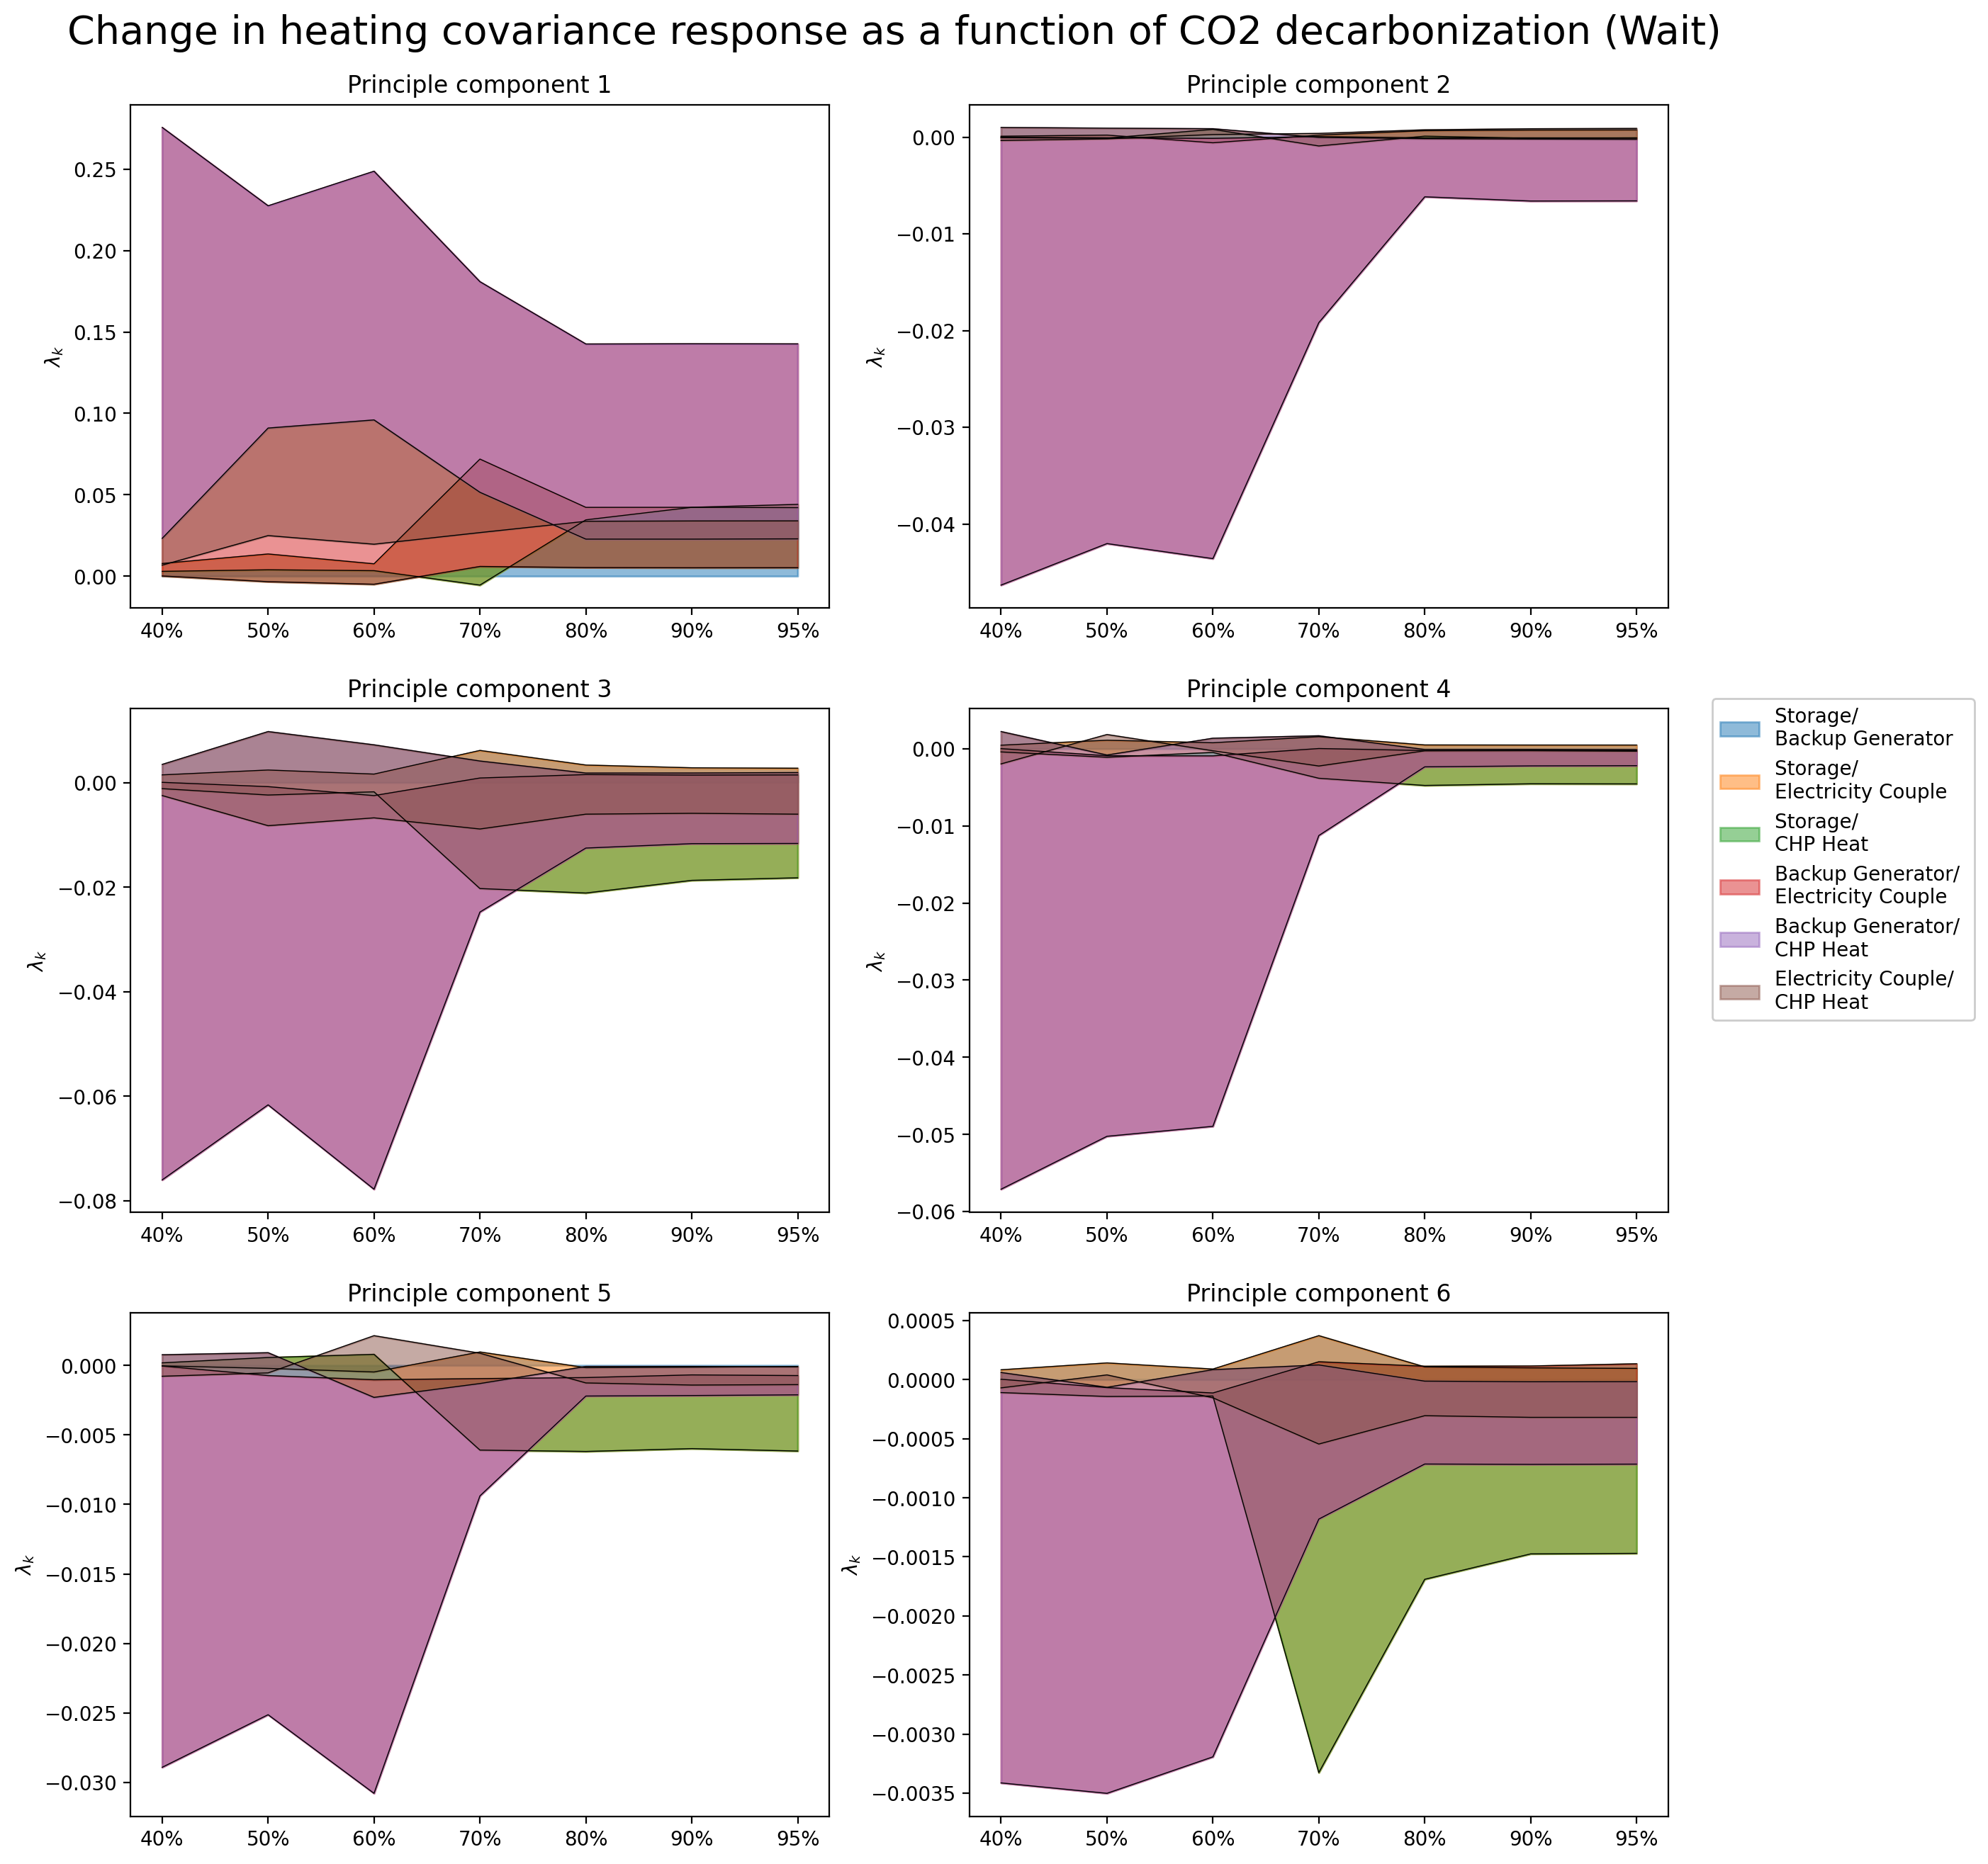
PCA – Change in Response (covariance terms)

Slide 23
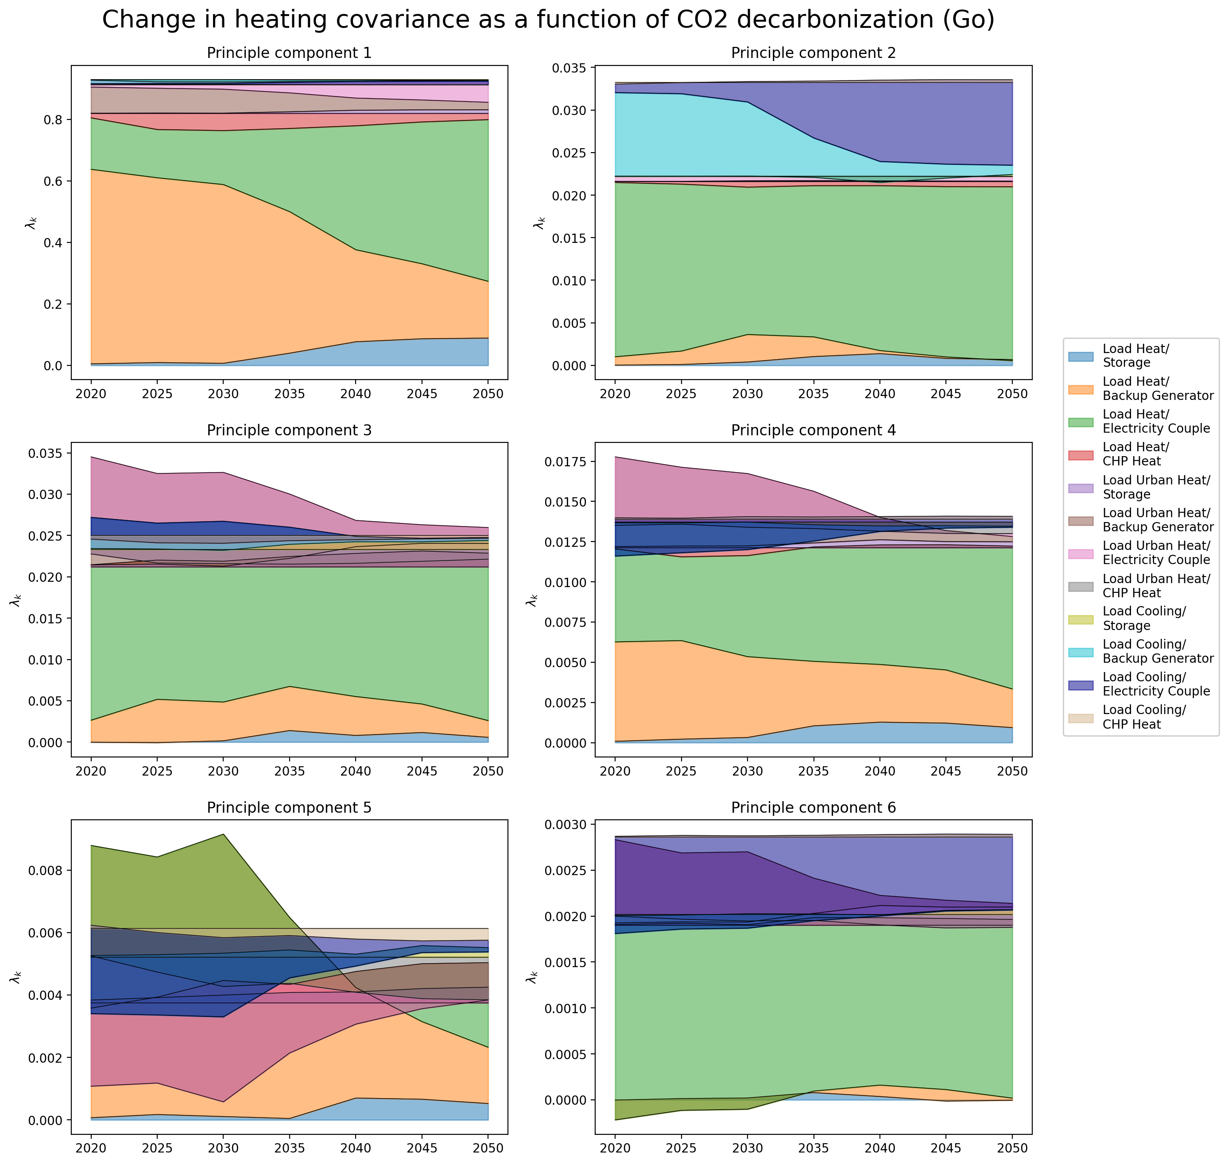
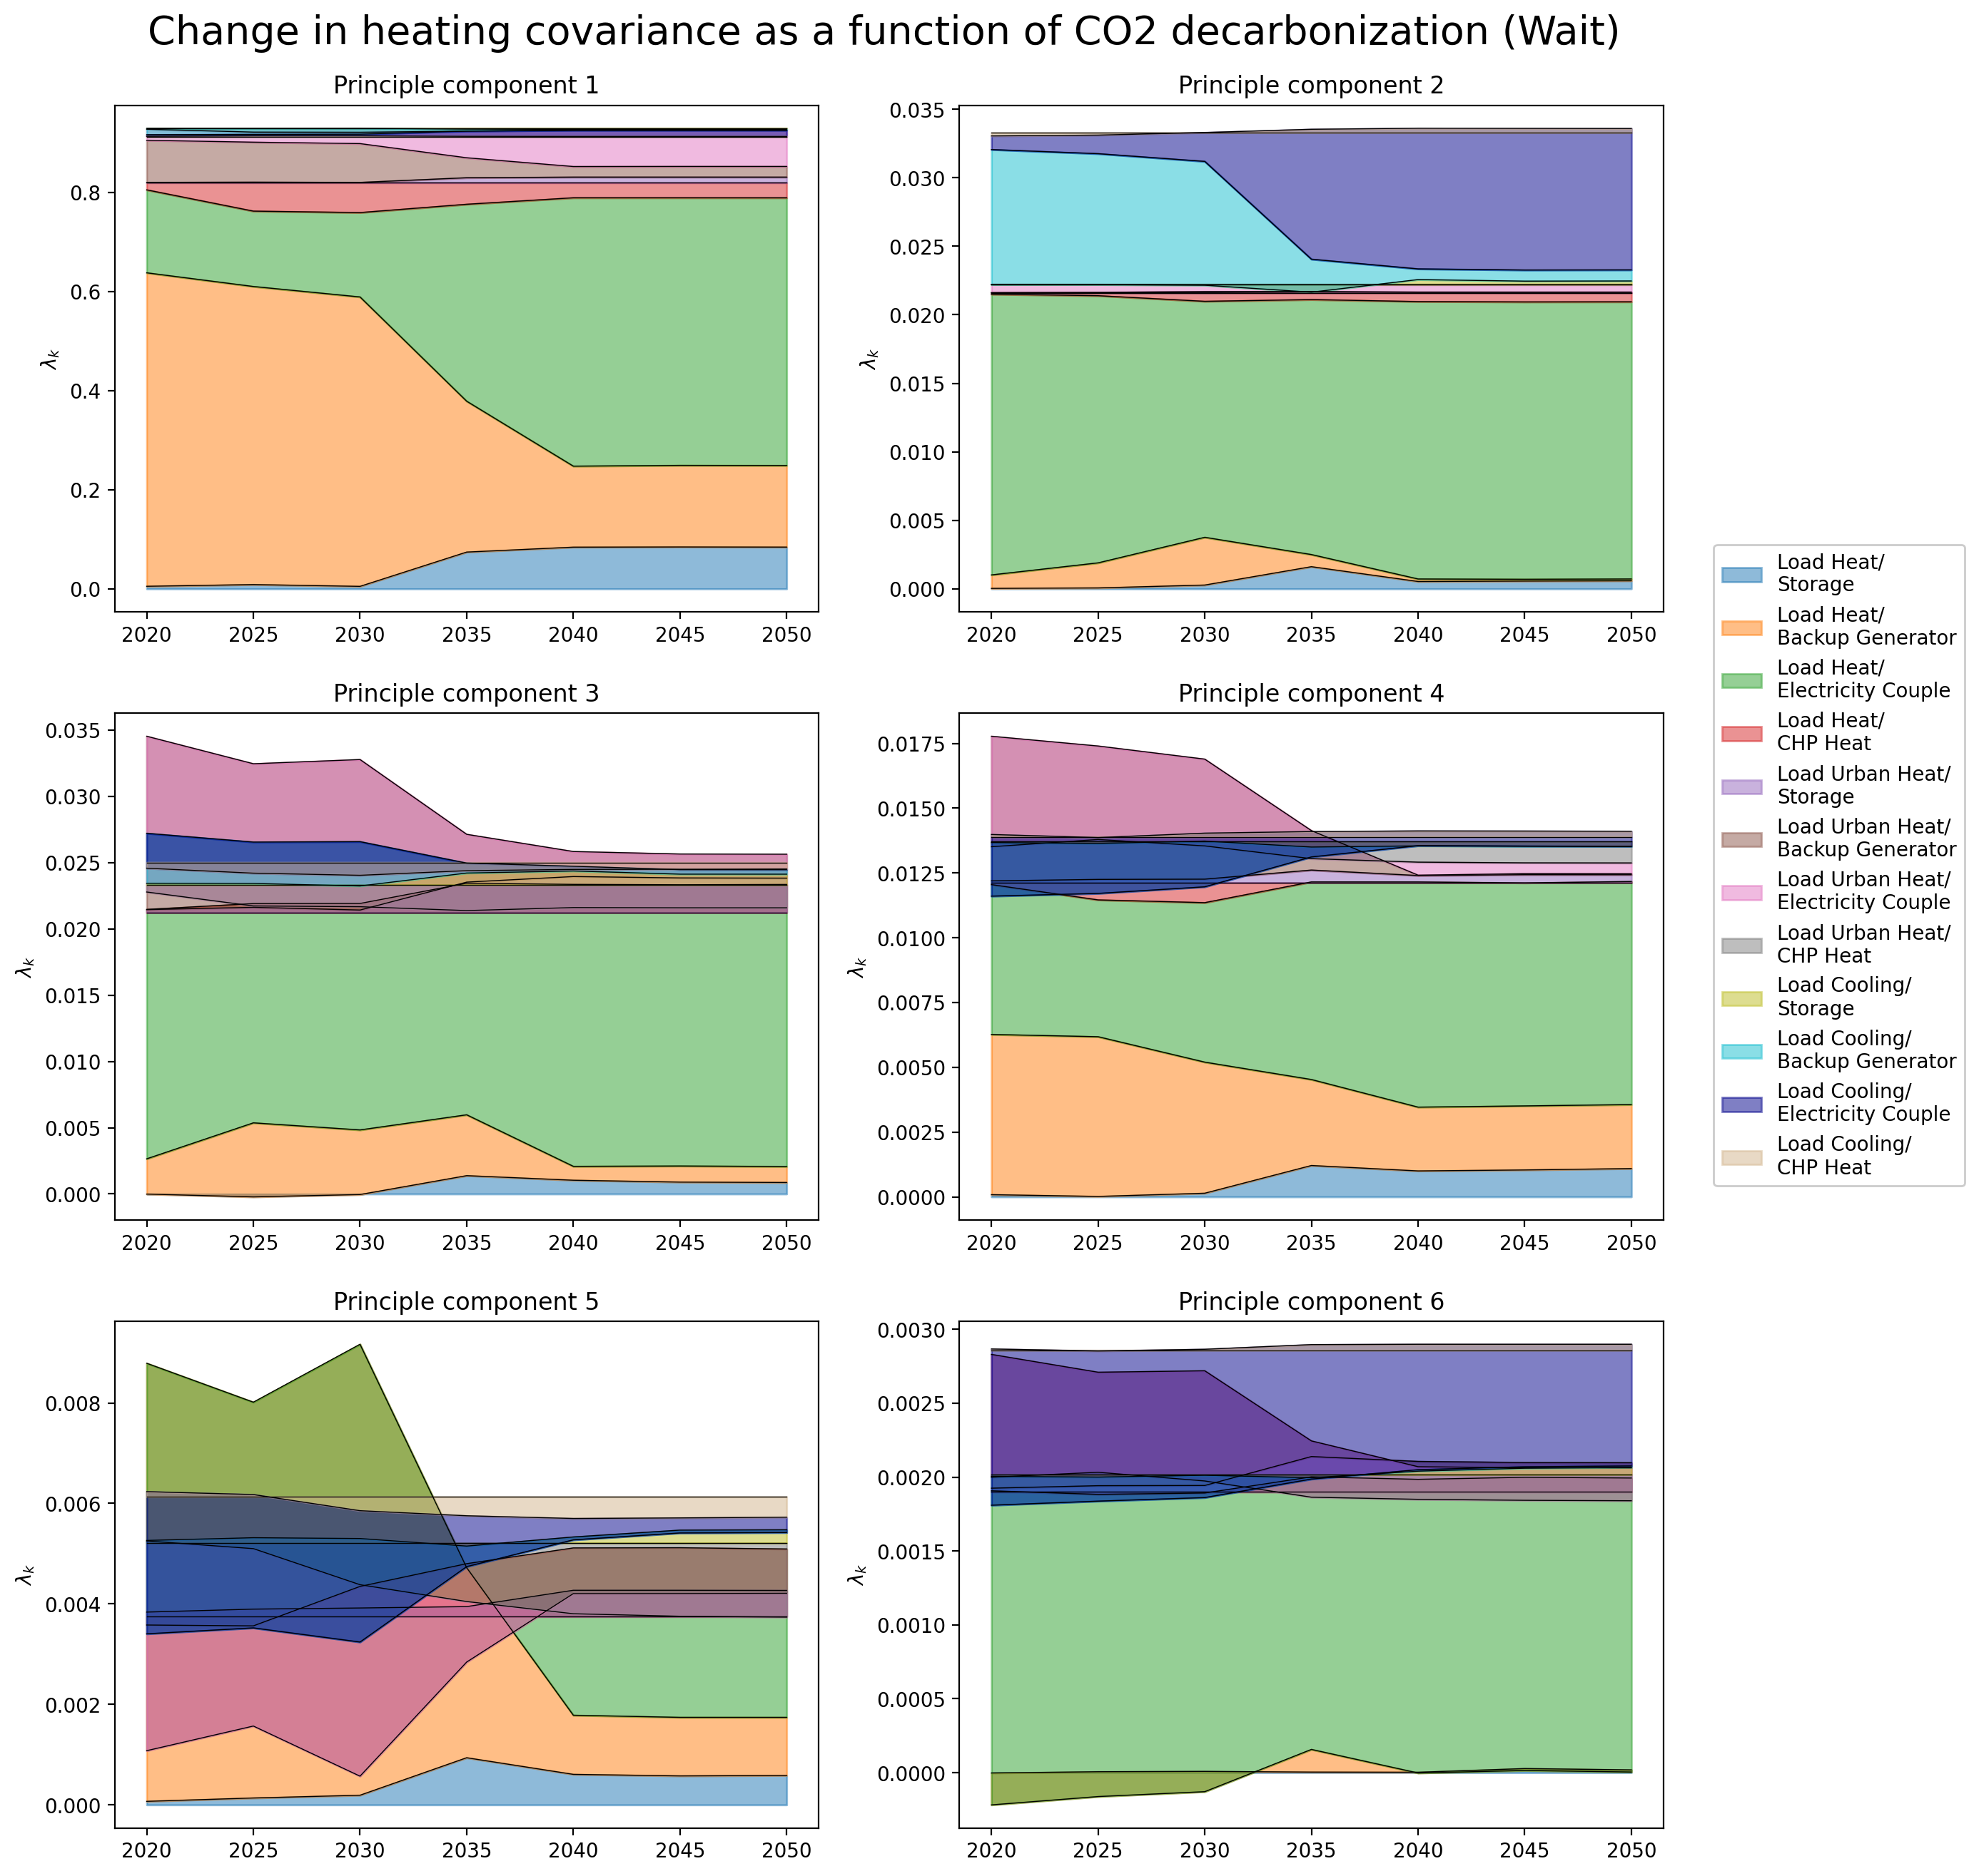
PCA – Change in Covariance

Slide 24
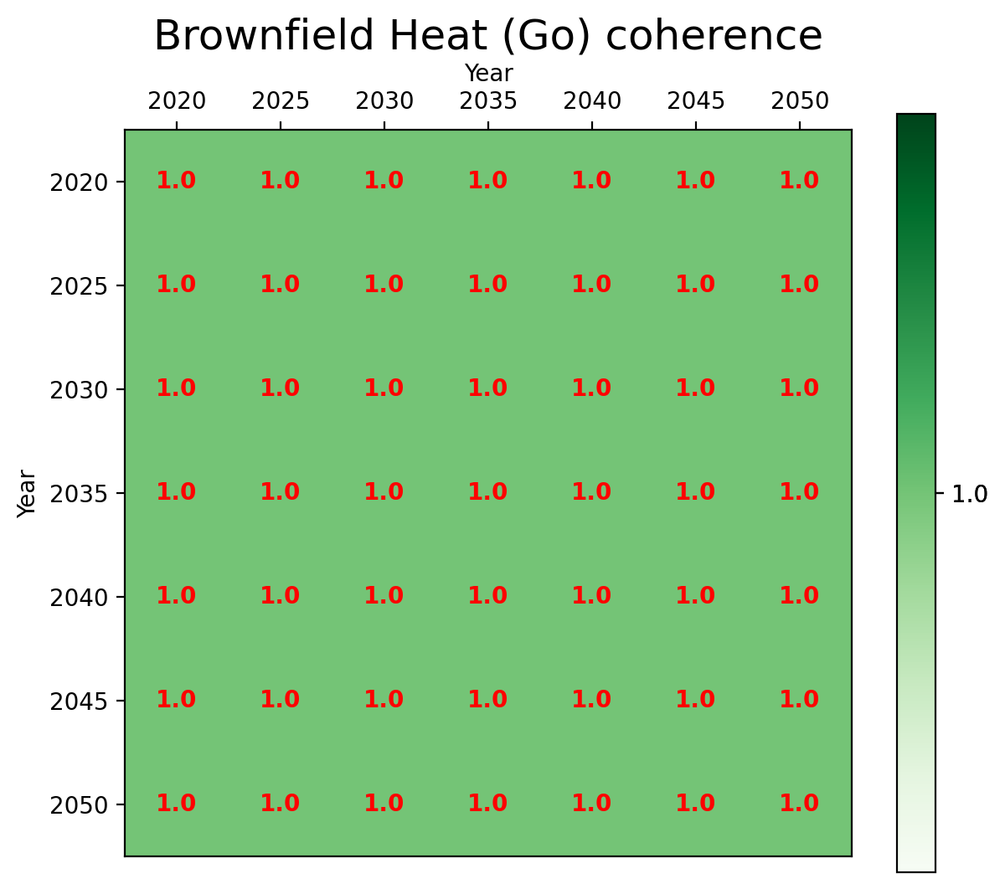

Coherence - Between Networks

Slide 25
Transition Path
Electricity Mismatch Analysis

Slide 26
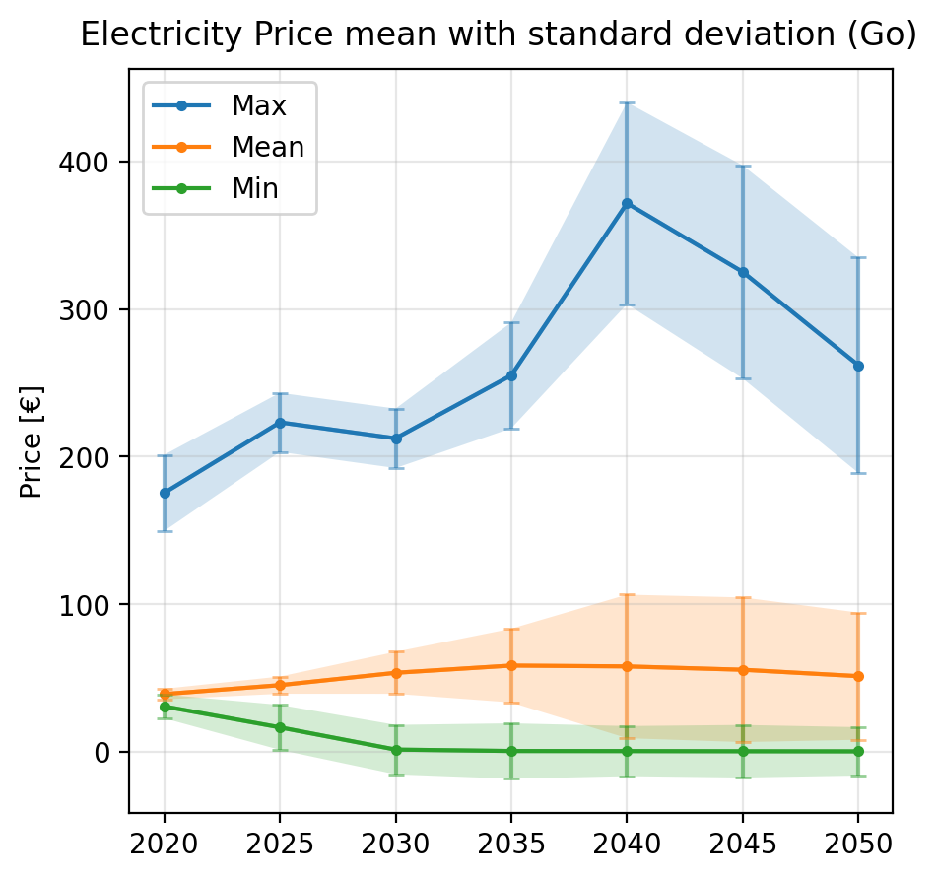
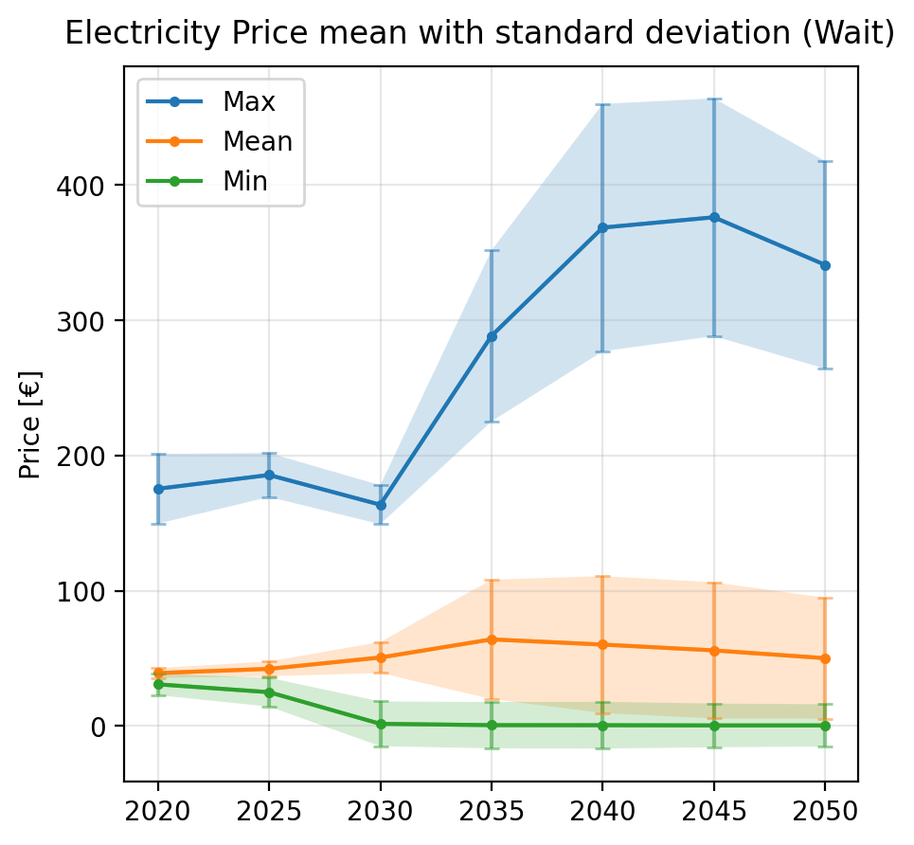
Pre-analysis – Mean values
Notes:
Prøv at vende det om så først tag min() / max() og derefter tag mean() på tværs af dem
Kig på arealet under kurven

Slide 27
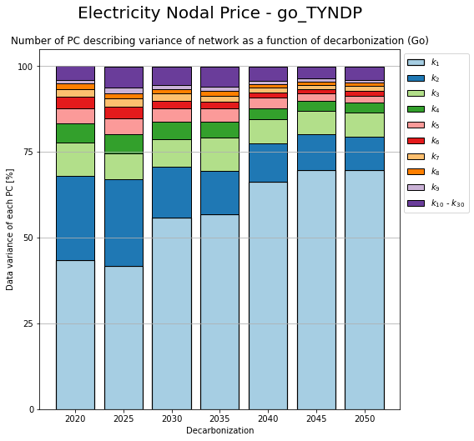
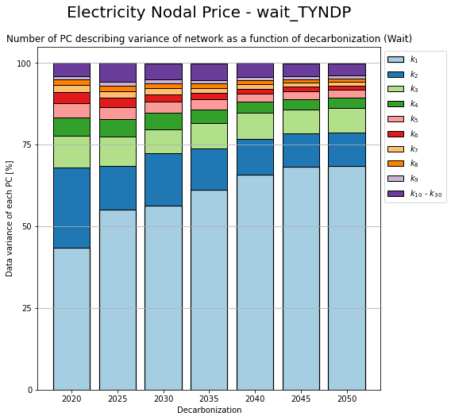
PCA – Change in components

Slide 28
Transition Path
Electricity Mismatch Analysis

Slide 29
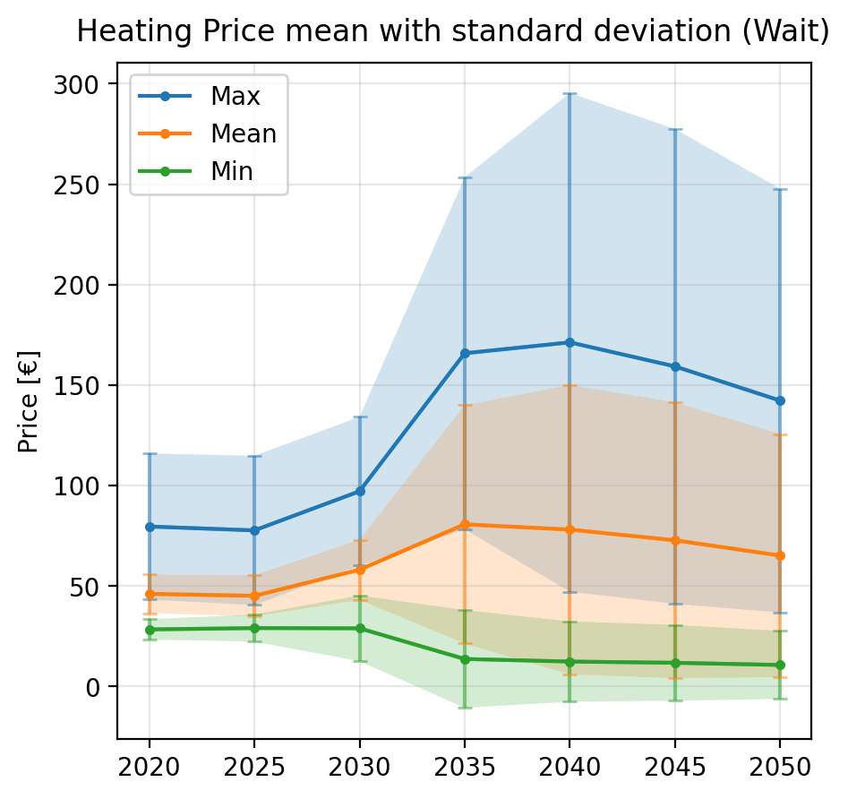
Pre-analysis – Mean values

Slide 30
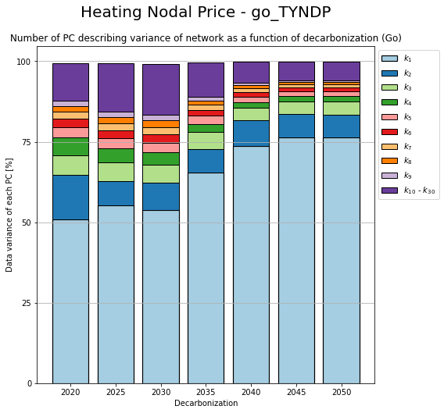
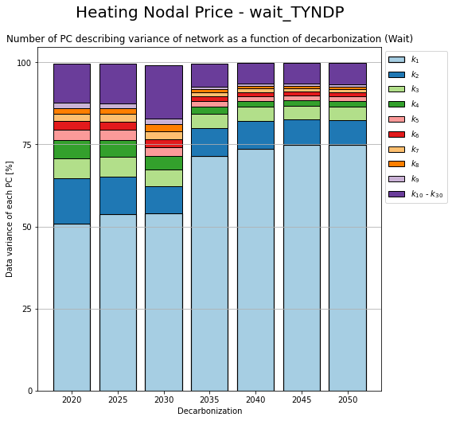
PCA – Change in components

Slide 31
Transition Path
Between mismatch and price

Slide 32
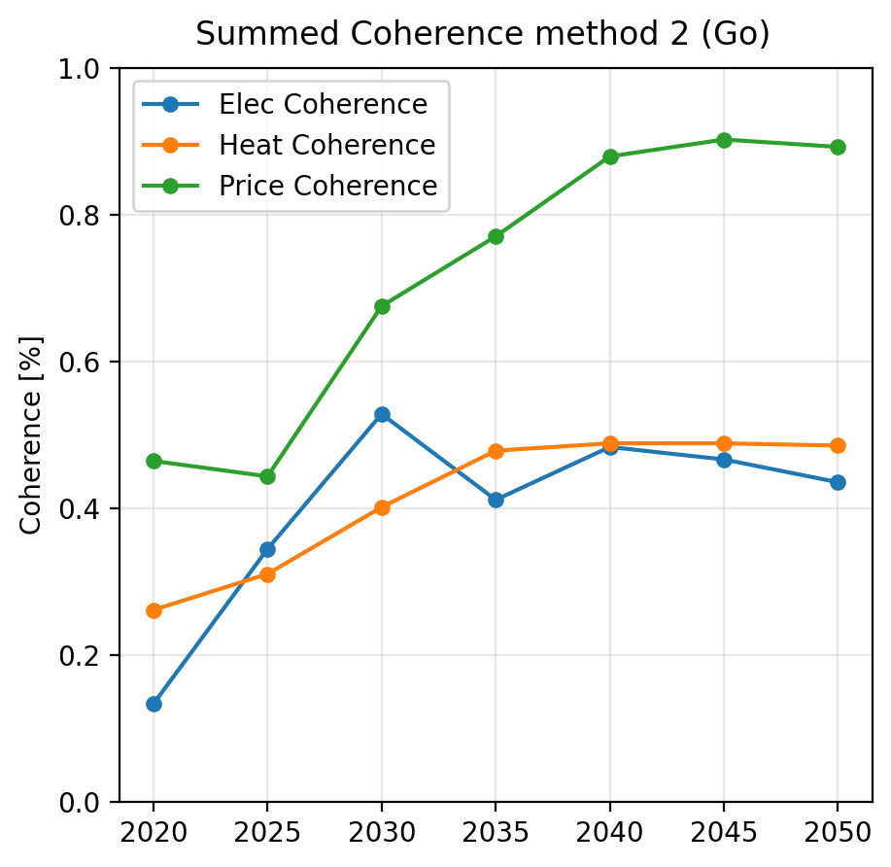
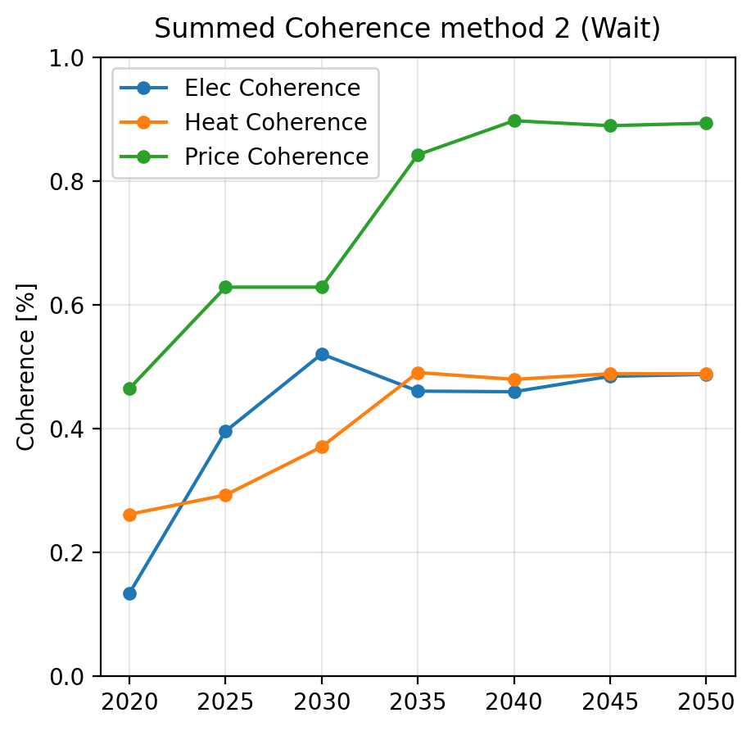
Coherence – Method 2

Slide 33
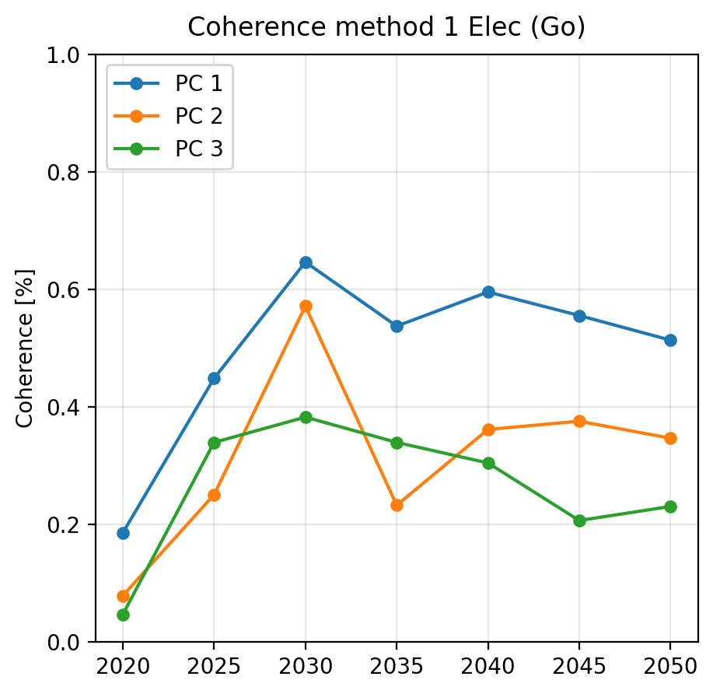
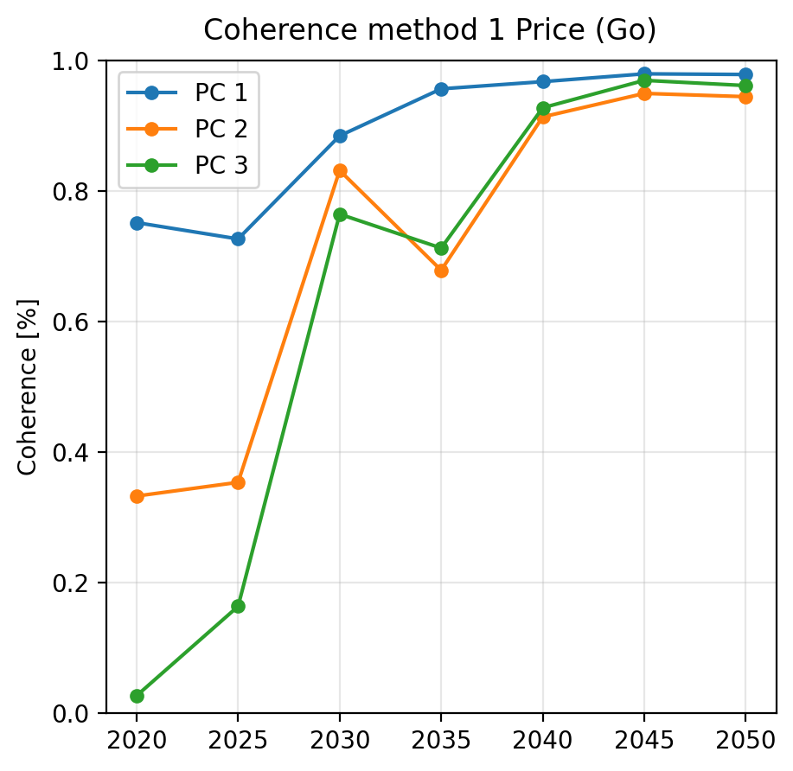

Coherence – Method 1

Slide 34



Coherence – Method 3

Slide 35

Coherence – Method 2

